Slide 1
Smart Environment and COVID: IPT Experiences using InterSCity platform for real cases
Igor C. Teixeira
Alessandro S. Santos (supervisor)
Seminário Aberto do Projeto InterSCity, 2020

Slide 2
Introduction
Application of new digital technologies for monitoring and managing environmental pollution and natural disasters - focusing on the challenges and computational opportunities - must be integrated with phenomenology
Space temporal analysis
Phenomenology
IoT devices
Integration phase
Acquiring real data
Cyberphysical Systems

Slide 3
Agenda and Challenges to Smart Environment
Air Pollution
Increase the spatial resolution of monitoring. The cost of automatic air quality monitoring stations is high ($ 350,000). Therefore, there is a demand for the validation of low-cost monitoring devices and its dissemination to various areas of the city.
Noise Pollution
Increase the spatial resolution of monitoring and validation of low-cost monitoring tools that can determine the sound profile of different parts of the city.
Natural Disasters
The cost of automatic landslide monitoring stations is very high.
Flood monitoring has communication and power supply problems. Today level and flow rate measure depend on manual data collection.
Worldwide biologic natural disaster
Rapid response to decision support to combat the coronavirus pandemic in São Paulo

Slide 4
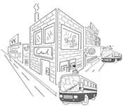
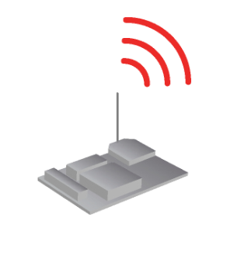
Smart Environment for Air pollution
Target: Air quality Monitoring to increase quality of life by deployment of intelligent public polices
Main Parameters
NO₂, CO, O₃
Temperature, air humidity, atmospheric pressure
Technological approach
WiFi

Slide 5
Results and perspectives
Infrastructure to improve air quality monitoring systems
Information to decision support for feet replacement by Eletric
Policies evaluation for restricting urban transport vehicles (i.e. create exclusive region for electric vehicles)

Slide 6
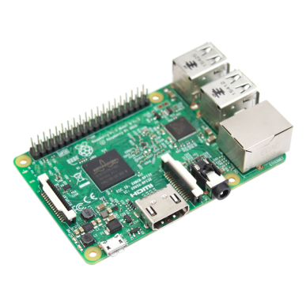
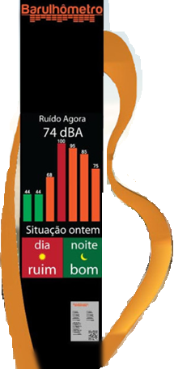
Smart Environment for Sound pollution
Target: noise monitoring to increase quality of life by deployment intelligent public polices
Main Parameters
Audio, pluviometry
Technological approach
WiFi
3G

Slide 7
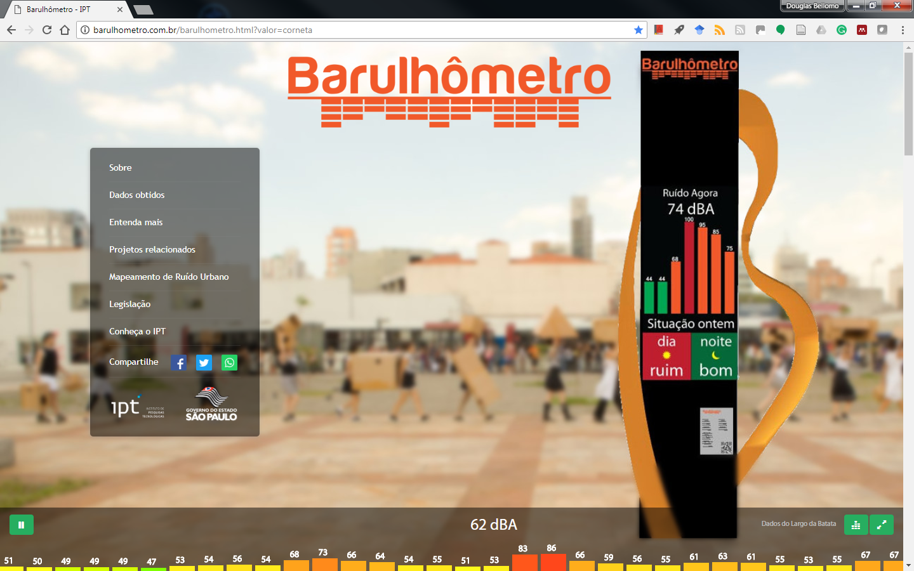
Results and perspectives
Graphic representation of the noise level distribution and the sound waves propagation in a given region for a defined period.
Barulhômetro (https://barulhometro.com.br/)
Waiting mayor decision to deployment

Slide 8
Smart Environment for Natural Disasters
Target:
For flooding: river flow and level to avoid economic damage and loss of life.
For landslide: rainfall data and displacement data.
Main parameters
for flooding: movement, pluviometry, air humidity, river flow and level data
for landslide: pluviometry, movement, temperature, air humidity, atmospheric pressure
Technological approach
Scraping BOT

Slide 9
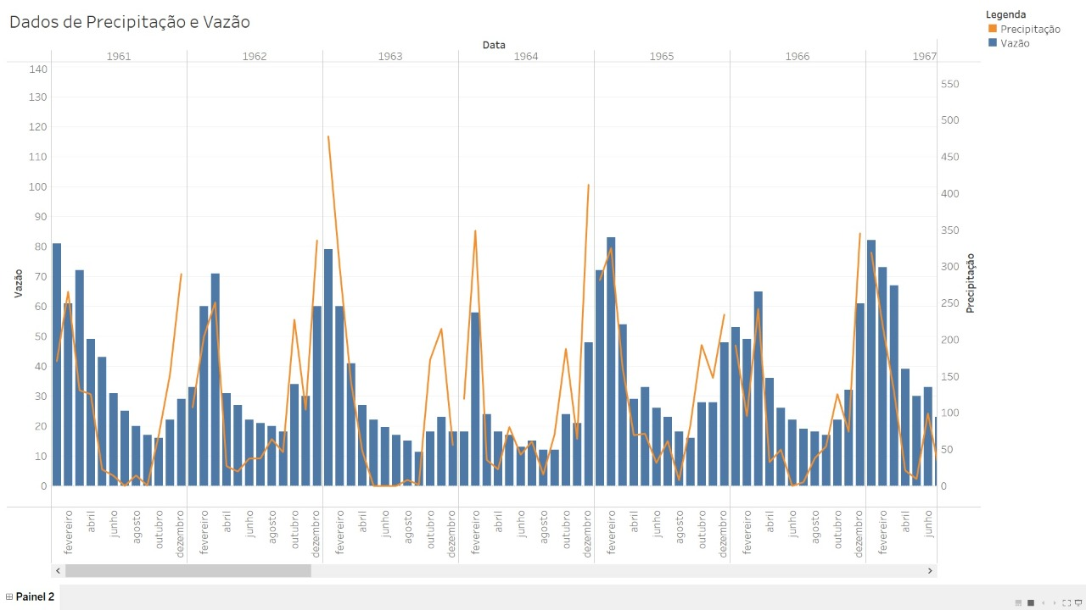
Results expected
Historical data (1937-2020) to analysis values that trigger landslides and floods.
Predict and real-time detect natural disasters avoiding economic damage and loss of life;

Slide 10
COVID Worldwide Biologic Natural disaster
Using InterSCity
for mobility monitoring

Slide 11
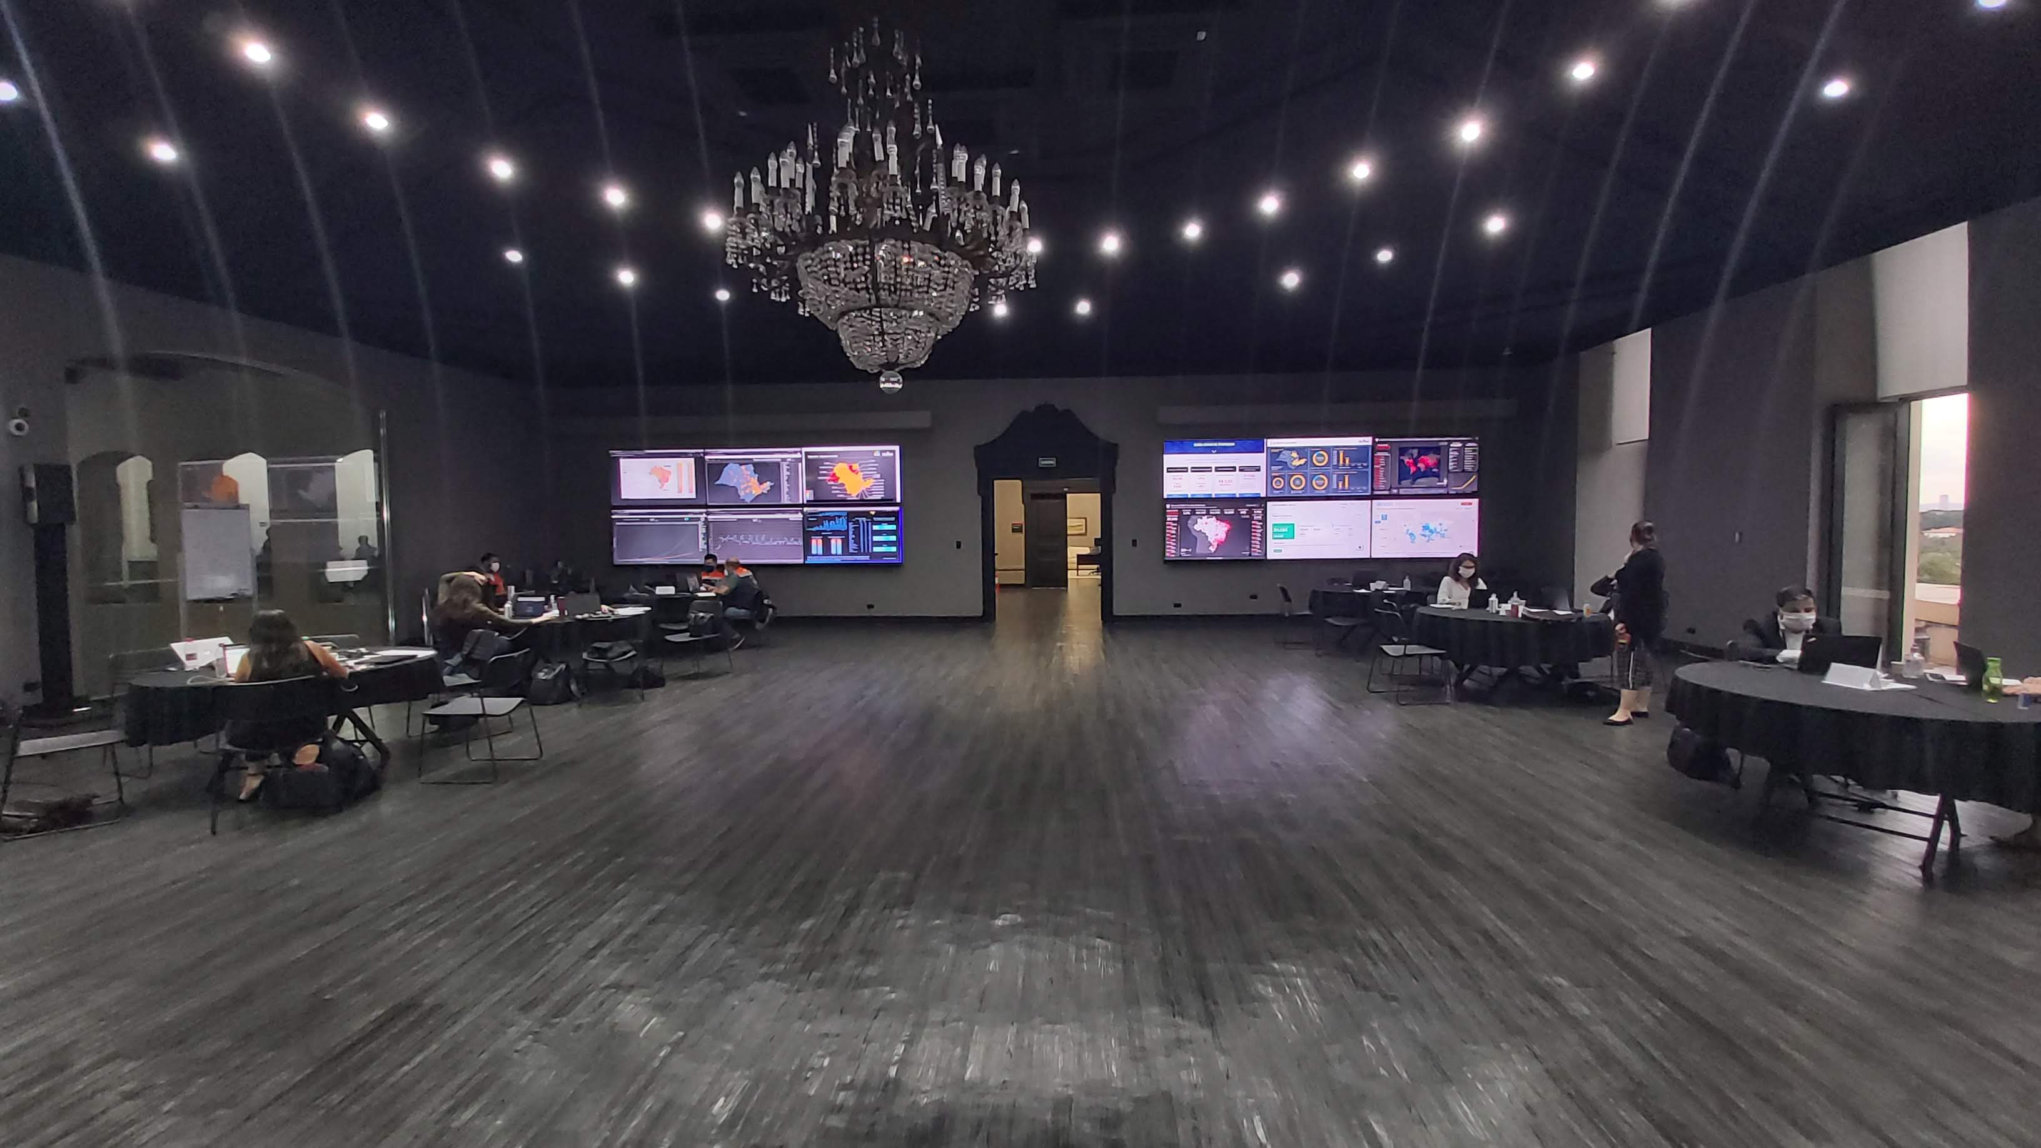
COVID-19 Crisis Control Center – São Paulo
“An computing environment supplies the São Paulo State Government with information aggregated and anonymized data on mobility, health, economy and others, supporting public authorities in strategic actions to confront the COVID-19”
decreto nº 64.963, maio 2020
Searching data sources
Integration on presentation layer
Systematic data collection
Data Visualization
Identifications and agreements
Understand the purpose, boundaries and spatiotemporal aspects
Integrate reports and graphs for COVID scenarios
Manual ou automatic data extraction
Calibration and improve data quality
Data validation and understanding
Dashboards for decission support
Challenge:
AGILE integration approach

Slide 12
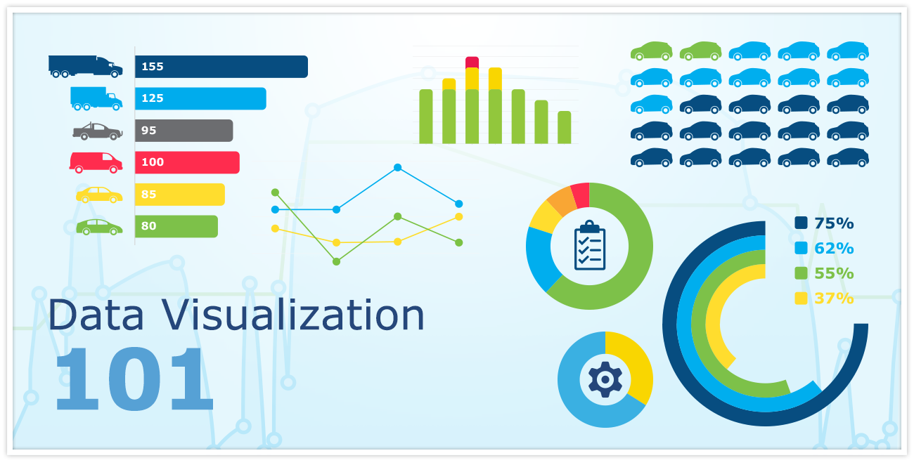
COVID-19 Crisis Control Center – São Paulo
InterSCity support the Control Center with agile integration for mobility scenarios
Intelligent Transportation Systems (hardware's and software's) are the information suppliers

Slide 13
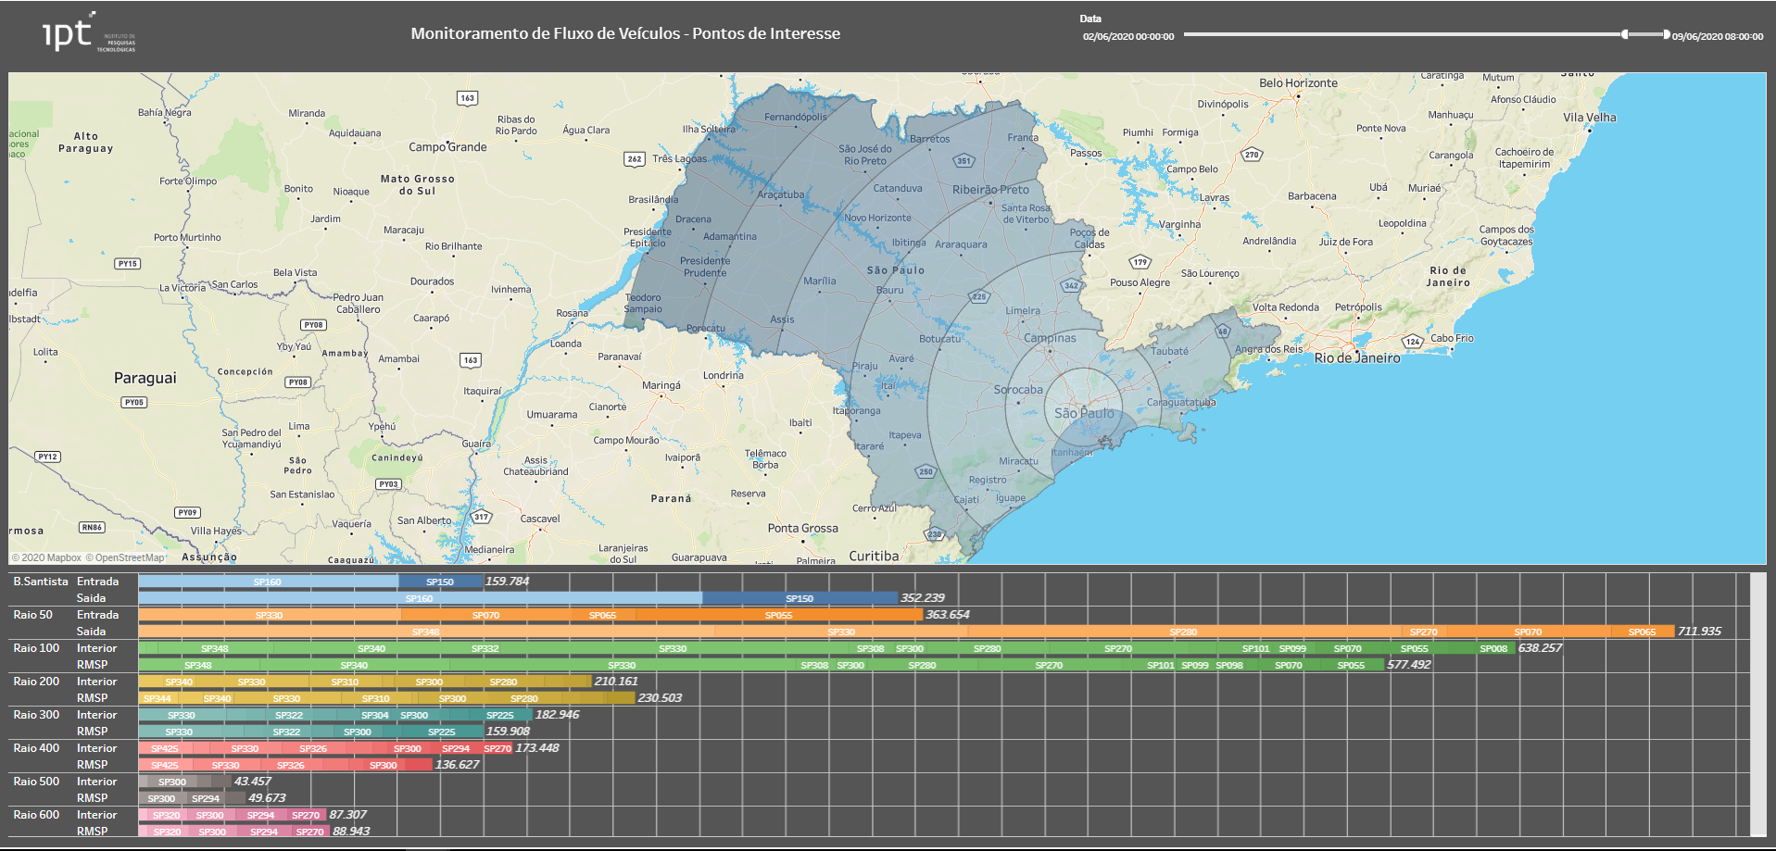
InterSCity supporting São Paulo Control Center
Main Sensors and System
Traffic counters
Speed camera
Automatic Vehicle identification (AVI)
Target for analyses
Traffic Flow
Matrix O-D (Origin-Destination)
Spread map for SARS-COV-2

Slide 14
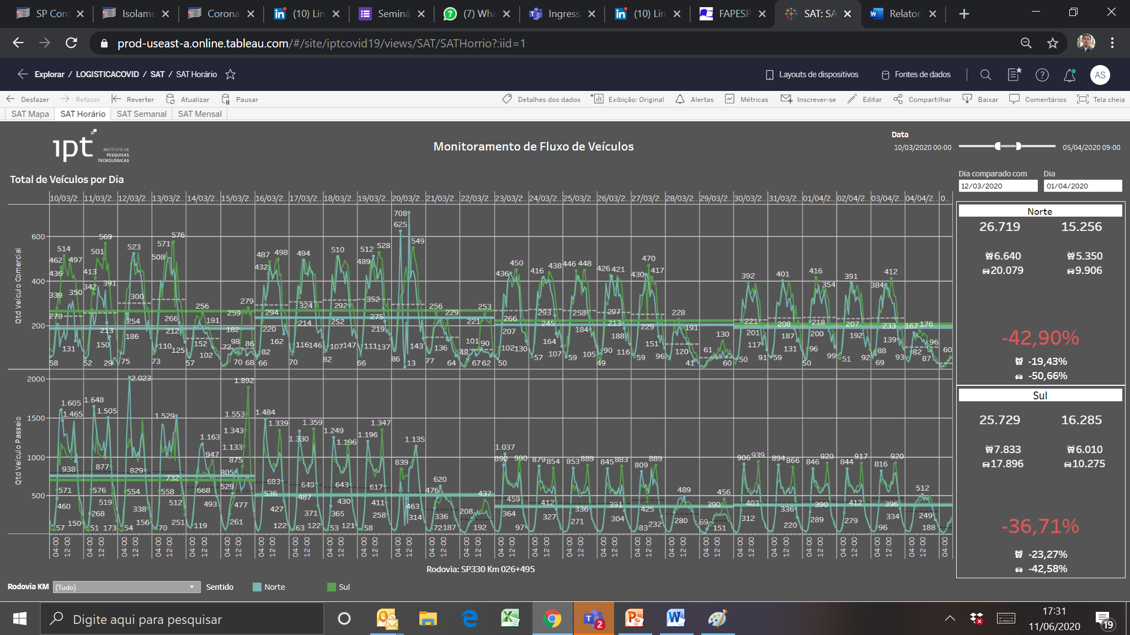
InterSCity supporting São Paulo Control Center
Traffic Flow
Matrix O-D
Automatic vehicle Identification
Toll Plaza with Lat/Long identification
Several rotes by vehicle kind

Slide 15
Results and perspectives
Mapping spread of COVID-19 using transport models
Rapid integration using JSON
Scalable and stable

Slide 16
Results and perspectives
Mapping spread of COVID-19 using transport models
Rapid integration using JSON
Scalable and stable
Eixo: Rod. Castelo Branco e Raposo Tavares
Eixo: Rod. Marechal Rondon
Contágio na 10ª semana seguiu rodovias do Estado de SP que conecta as principais cidades do interior
Eixo: Rod. Washington Luiz
Eixo: Anhanguera
Além da distribuição até 200 km pelos Sistemas Anhanguera-Bandeirantes, Anchieta-Imigrantes, e Rodovias próximas à RMSP

Slide 17
Conclusions
We are collecting data to supply bases to new computing approach
Future works
New aspects from smart environment
Calibration aspects

Slide 18
Thank you!!!
igort@ipt.br
alesan@ipt.br

