Slide 1
Seasonal variation in mortality in Brazil
Victor Foscarini Almeida
Advisor: Prof. Fabio Kon (IME-USP)
Co-Advisor: Prof. Raphael Yokoingawa de Camargo (UFABC)
Thesis committee: Prof. Fabio Kon (IME-USP)
Prof. Paulo Hilario Nascimento Saldiva (FM-USP)
Prof. Rudi Rocha (EAESP-FGV)
Department of Computer Science
Institute of Mathematics and Statistics
University of São Paulo
São Paulo, August 1st, 2024

Slide 2
Contents
1 - Introduction
2 - Background
3 - Related Work
4 - Methodology
5 - Results
6 - Discussion
7 - Conclusion

Slide 3
Motivation
Seasonality is important
Excess winter death
Climate factors
Socioeconomic factors
Brazil is a strategic country
Source: DALL-E

Slide 4
Objectives
RQ1: How can we effectively measure the seasonal variation in mortality in heterogeneous contexts?
RQ2: What is the seasonality of mortality in Brazil, and how does it vary geographically and by cause of death?
RQ3: What environmental factors are more associated with that seasonality?
Interactive Dashboard

Slide 5
Contributions
A new methodology to effectively measure the seasonal variation in mortality in heterogeneous contexts.
An understanding of the geographical variation of the seasonality in Brazil.
An insight on climate factors associated with the seasonality.

Slide 6
Contents
1 - Introduction
2 - Background
3 - Related Work
4 - Methodology
5 - Results
6 - Discussion
7 - Conclusion

Slide 7
Brazilian Healthcare System - SUS
Principles of universality, equality, and completeness
Decentralized and hierarchical
Federal government
State government
Municipal governments
DATASUS and SIM-DATASUS
Source: Wiki

Slide 8
Epidemiological Methods
Epidemiology as “the study of how disease is distributed in populations and the factors that influence or determine this distribution”
(CELENTANO and SZKLO, 2018)
Related to data science
Confounding variables
Source: Enago

Slide 9
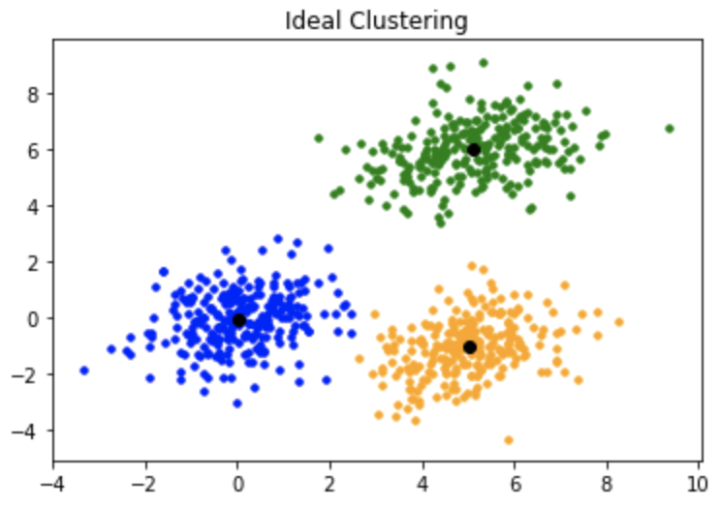
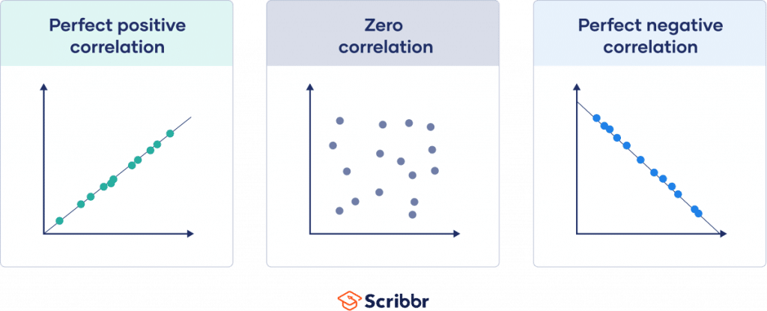
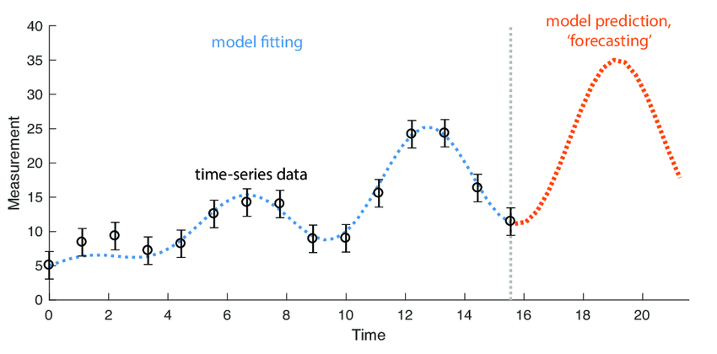
Statistical Analysis
Descriptive Analysis
Clustering
Time Series Modeling
Correlation
Clustering
Time Series Modeling
Source: Scribbr
Source: geeksforgeeks
Source: Fulcher, 2017

Slide 10
Measuring the seasonal variation in mortality
Winter to Summer Difference in Mortality (WSDM)
Excess Winter Death index (EWDi)
Peak-to-Trough Ratio (PTR)

Slide 11
Contents
1 - Introduction
2 - Background
3 - Related Work
4 - Methodology
5 - Results
6 - Discussion
7 - Conclusion

Slide 12
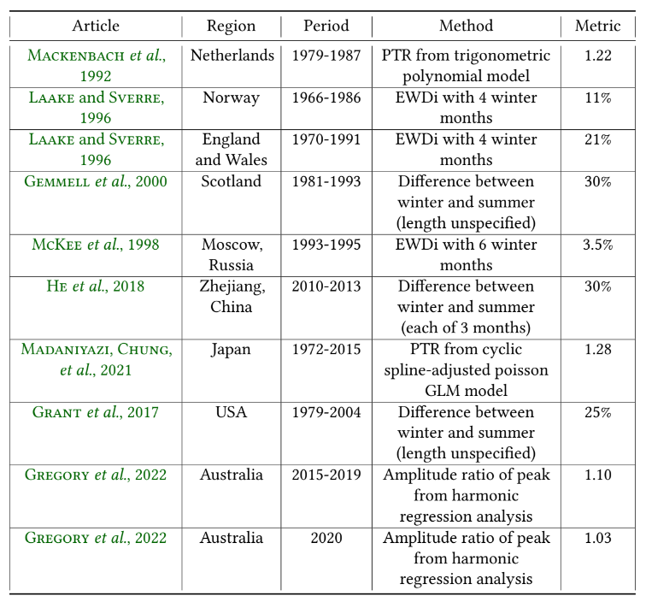
Regional studies
(outside Brazil)
Most excess winter deaths come from diseases of the circulatory system (direct climate effect) and respiratory system (delayed climate effect)
Confident evidence of the role of age and somewhat of gender
Unconfident evidence of the role of housing and social class

Slide 13
Regional studies
(in Brazil)
Most of the literature is analysing a single cause (e.g. myocardial infarction) or a single city (e.g. São Paulo)
The effect of low temperatures on mortality is larger than that of high temperatures

Slide 14
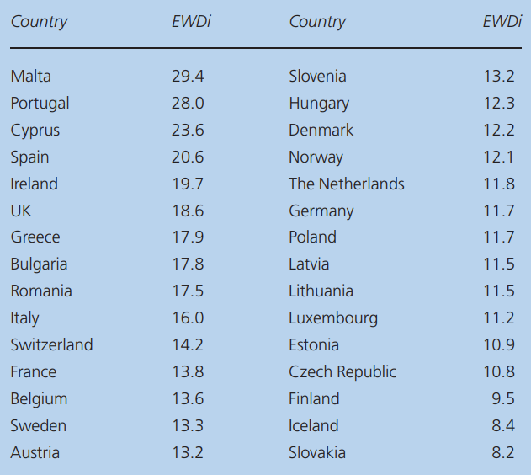
About EWDi
Excess winter mortality paradox
Infrastructure
Climate
Constraints
Length
Position
Excess Winter Death index by country in Europe (LIDDEL et al., 2016)

Slide 15
Studies on a large scale
Comparing the seasonality of different regions
PTR (with & without temperature adjustment)

Slide 16
Contents
1 - Introduction
2 - Background
3 - Related Work
4 - Methodology
5 - Results
6 - Discussion
7 - Conclusion

Slide 17
Contents
4 - Methodology
Data Sources
Investigating Seasonality
Investigating Seasonality Factors

Slide 18
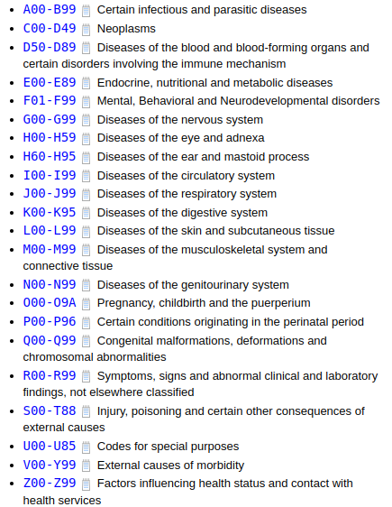
Data Sources
Mortality: SIM-DATASUS
ICD-10 codes
Demographic: IBGE
Population estimation and Census
Climate: INMET
Historical data from automatic stations
Ex: Temperature, Atmospheric Pressure, Humidity, Precipitation,

Slide 19
Contents
4 - Methodology
Data Sources
Investigating Seasonality
Investigating Seasonality Factors

Slide 20
Investigating seasonality
Data Processing
Single-year aggregated mortality time series of 2000-2019 with over 22 million deaths
Standardized death rates using total Brazil as standard population, considering confounding variables Age & Sex

Slide 21
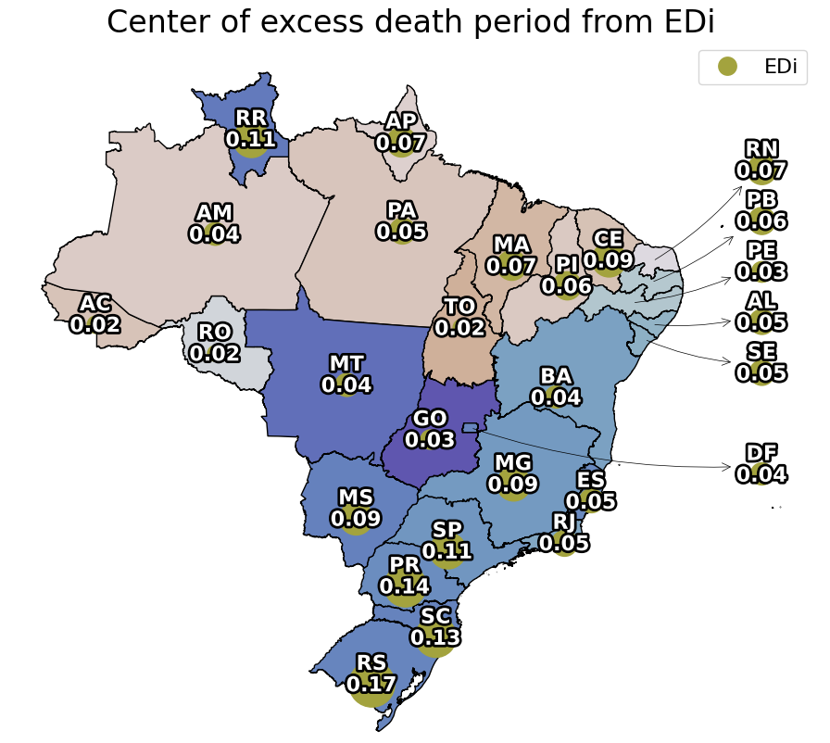
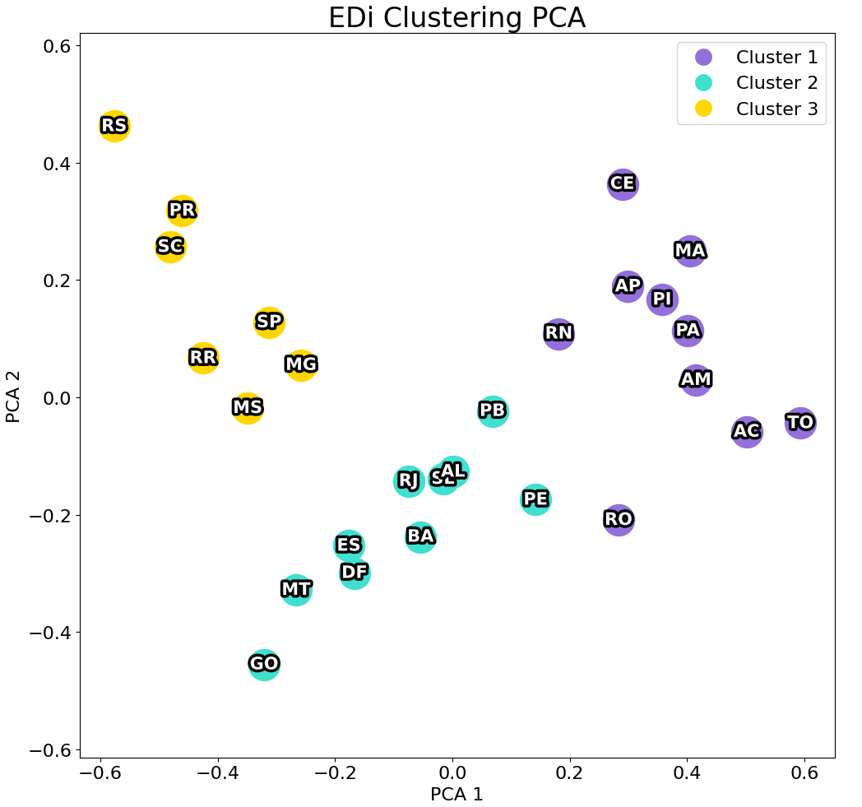
Investigating seasonality
Data analysis
Choropleth maps to visualize metrics
K-Nearest Neighbors to cluster states according to seasonality metrics results:
Value
Timing
Length

Slide 22
Investigating seasonality
Excess Winter Death index (EWDi)
Simple
Define EWDi for southern hemisphere

Slide 23
Investigating seasonality
Our proposal 1: Excess Death index (EDi)
Simple
Iterate over all periods of 4-month length
Removes EWDi’s period constraint

Slide 24
Investigating seasonality
Our proposal 2: Excess Death with Varying Length index (EDVLi)
Complex
Change point detection algorithm
Removes EWDi’s period and length constraint

Slide 25
Investigating seasonality
Peak-to-Trough Ratio (PTR)
Complex
Curve smoothing algorithm: cyclic cubic spline

Slide 26
Contents
4 - Methodology
Data Sources
Investigating Seasonality
Investigating Seasonality Factors

Slide 27
Investigating Seasonality Factors
Single-year aggregated time series of weather measurements from 2013-2018 for all state capitals
Focus on: São Paulo, Rio de Janeiro, Fortaleza
Dew Point Temperature as a combination of Dry Bulb Temperature and Relative Humidity
Correlation implies association and not causation

Slide 28
Contents
1 - Introduction
2 - Background
3 - Related Work
4 - Methodology
5 - Results
6 - Discussion
7 - Conclusion

Slide 29
Contents
5 - Results
Investigating Seasonality
Investigating Seasonality Factors
Dashboard

Slide 30
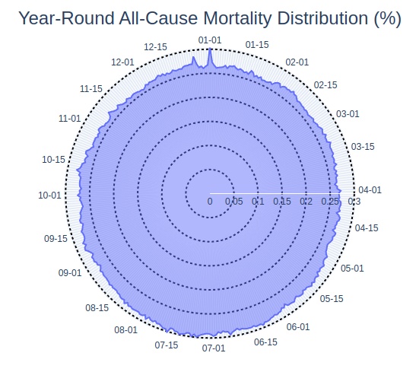
Investigating Seasonality
In Brazil
Excess winter mortality
Peak at the beginning of July
Varies across the country, being more representative of southern states

Slide 31
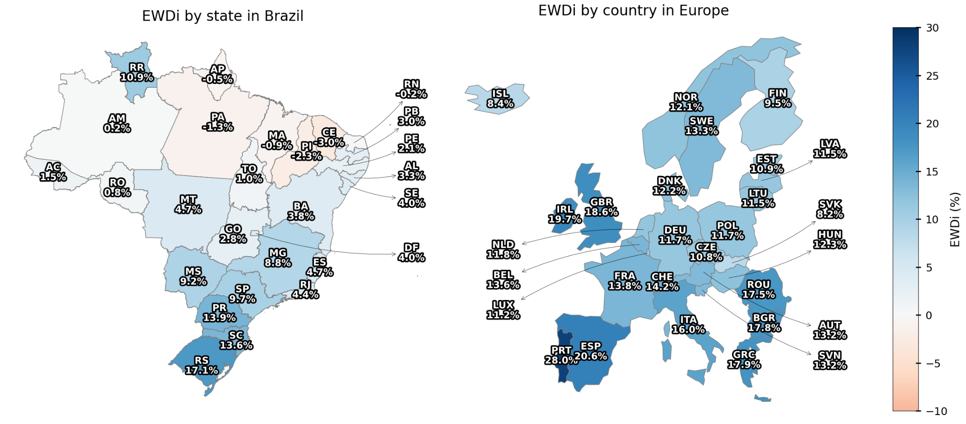
Investigating Seasonality
Excess Winter Death index (Brazil vs. Europe)
‹#›

Slide 32
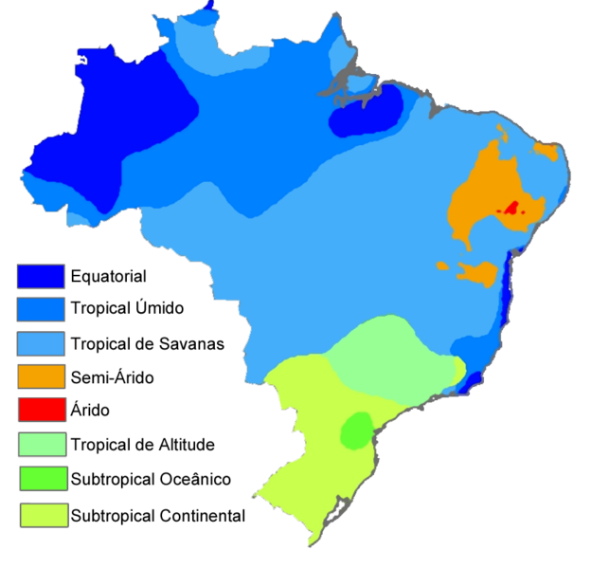
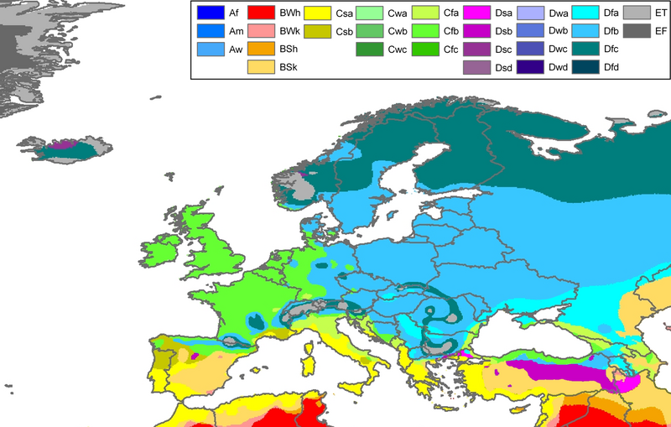
Investigating Seasonality
Climate (Brazil vs. Europe)
‹#›
Source: Wiki
Source: Wiki

Slide 33
Investigating Seasonality
EWDi clustering
‹#›

Slide 34
Investigating Seasonality
Contribution to EWDi by cause of death
‹#›

Slide 35
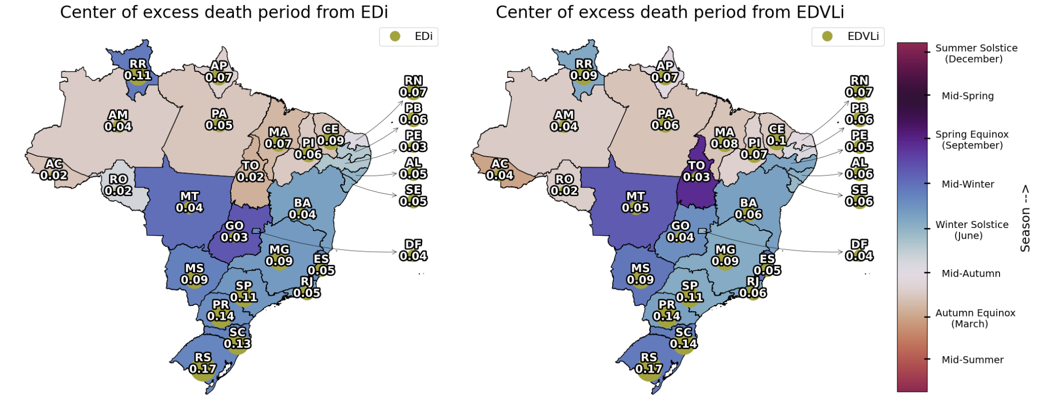
Investigating Seasonality
Excess Death index (EDi)
‹#›

Slide 36
Investigating Seasonality
EDi clustering
‹#›

Slide 37
Investigating Seasonality
EDVLi clustering
‹#›

Slide 38
Investigating Seasonality
Contribution to EDi by cause of death
‹#›

Slide 39
Investigating Seasonality
Contribution to EDVLi by cause of death
‹#›

Slide 40
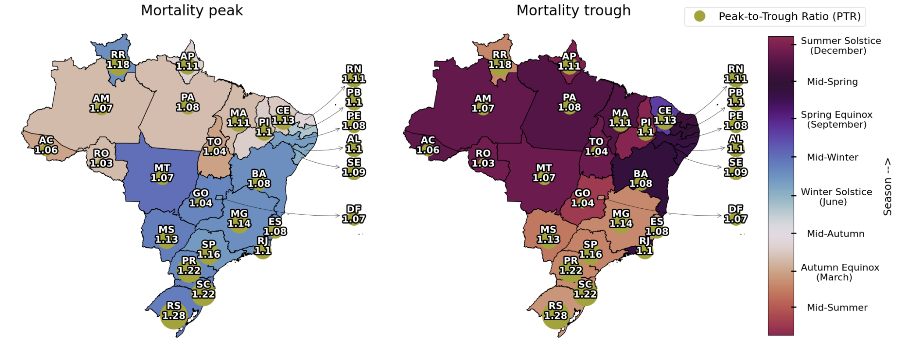
Investigating Seasonality
Peak-to-Trough Ratio (PTR)
‹#›

Slide 41
Investigating Seasonality
PTR clustering
‹#›

Slide 42
Contents
5 - Results
Investigating Seasonality
Investigating Seasonality Factors
Dashboard

Slide 43
Investigating seasonality factors
Correlation hints on relationship between climate and mortality
Dew Point Temperature supremacy
Dry Bulb Temperature
Relative Humidity
Unclear instant vs. delayed relationship

Slide 44
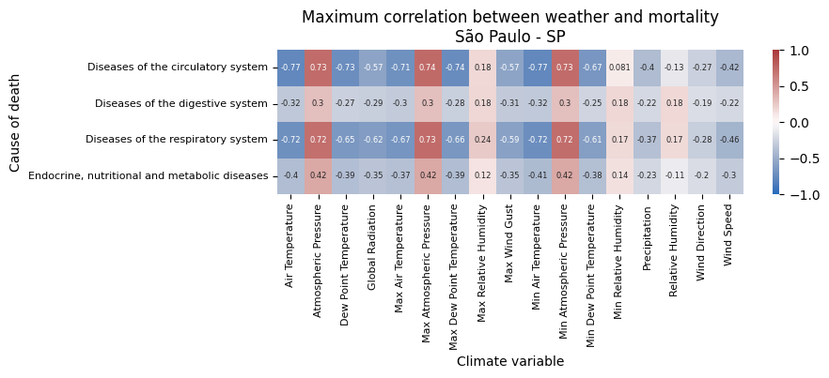
Investigating Seasonality Factors
Weather vs. Mortality - São Paulo
‹#›

Slide 45
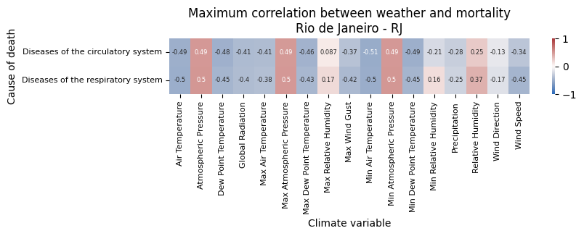
Investigating Seasonality Factors
Weather vs. Mortality - Rio de Janeiro
‹#›

Slide 46
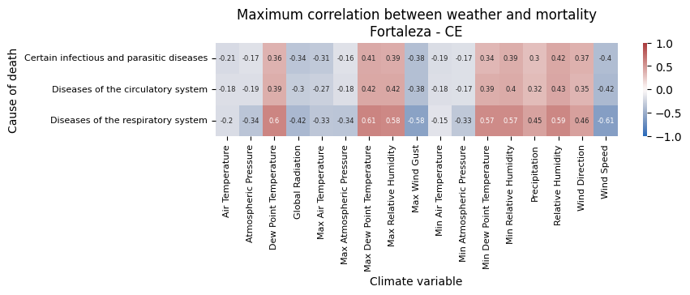
Investigating Seasonality Factors
Weather vs. Mortality - Fortaleza
‹#›

Slide 47
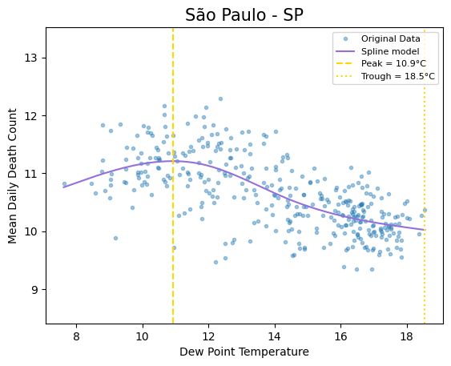
Investigating Seasonality Factors
Dew Point Temperature vs.
Mortality
(São Paulo)
‹#›

Slide 48
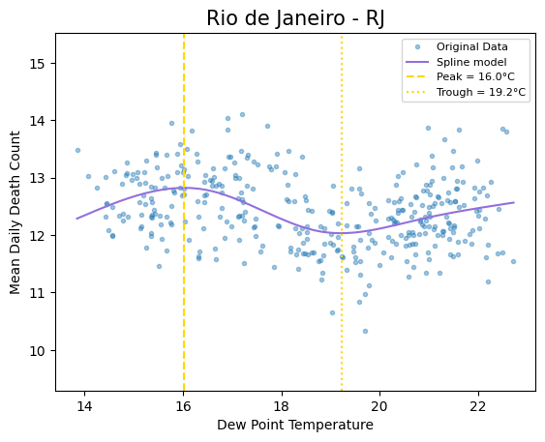
Investigating Seasonality Factors
Dew Point Temperature vs.
Mortality
(Rio de Janeiro)
‹#›

Slide 49
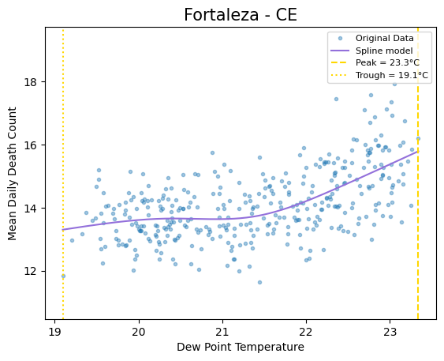
Investigating Seasonality Factors
Dew Point Temperature vs.
Mortality
(Fortaleza)
‹#›

Slide 50
Contents
5 - Results
Investigating Seasonality
Investigating Seasonality Factors
Dashboard

Slide 51
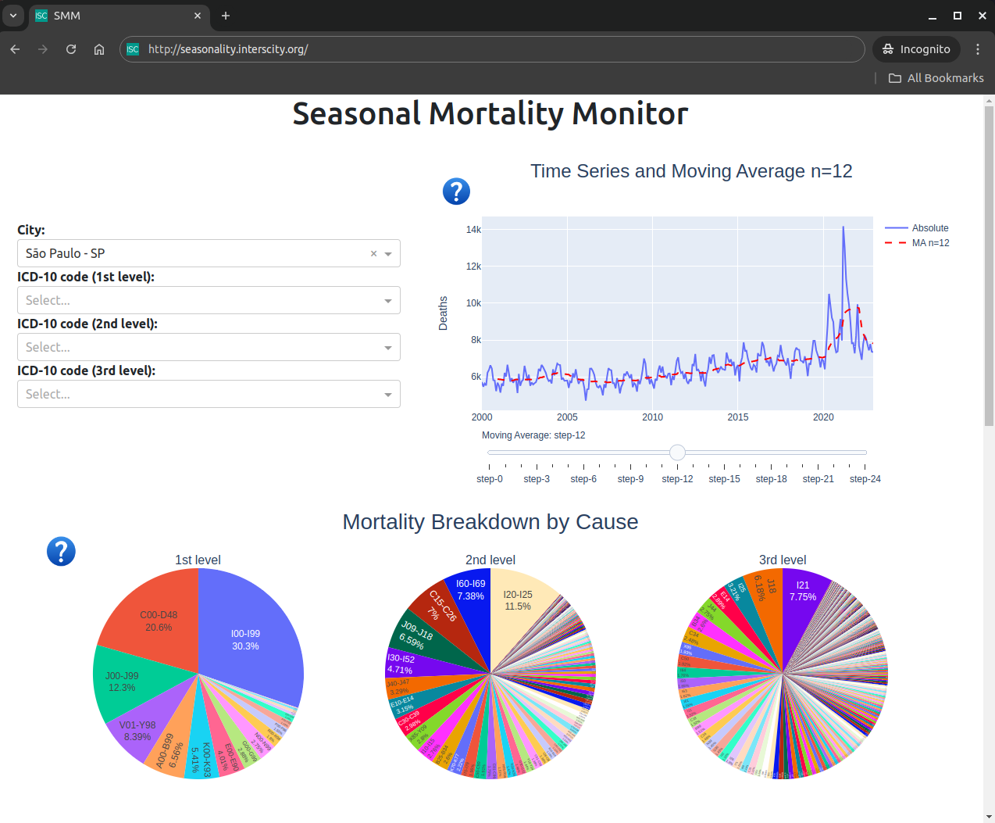
Dashboard
(http://seasonality.interscity.org/)

Slide 52
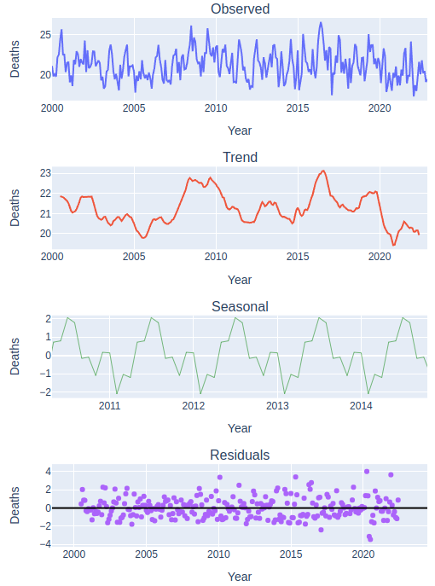
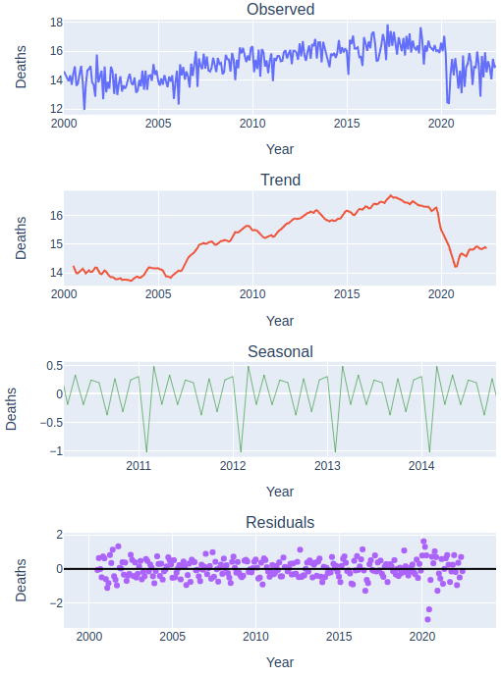
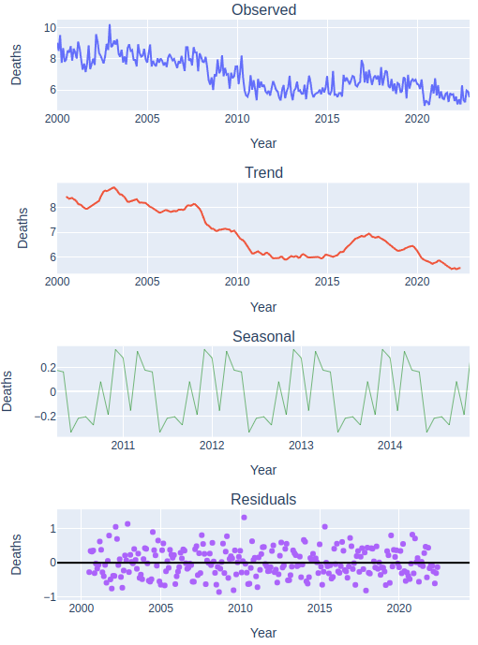
Dashboard: TS decomposition
Rio de Janeiro
Diseases of the circulatory system
Neoplasms
External causes of morbidity

Slide 53
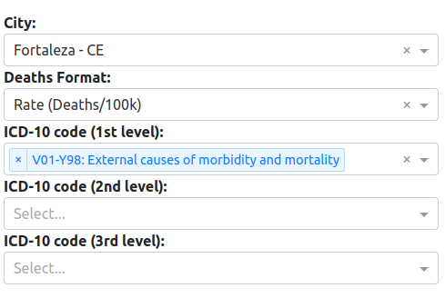
Dashboard: External Causes of Morbidity
Fortaleza

Slide 54
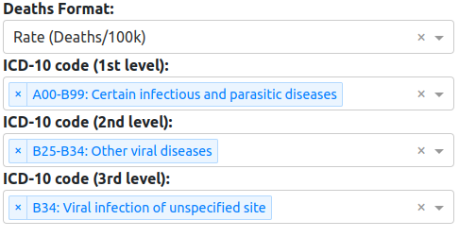
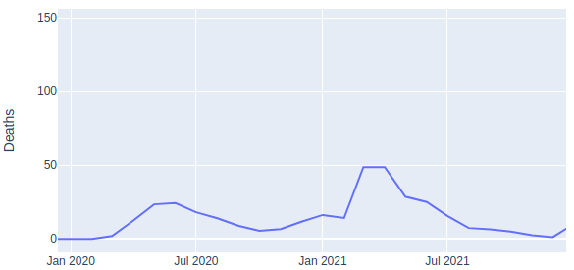
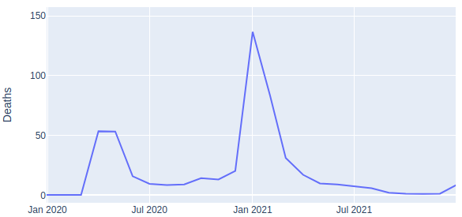
Dashboard: COVID-19
São Paulo vs. Manaus
São Paulo - SP
Manaus - AM

Slide 55
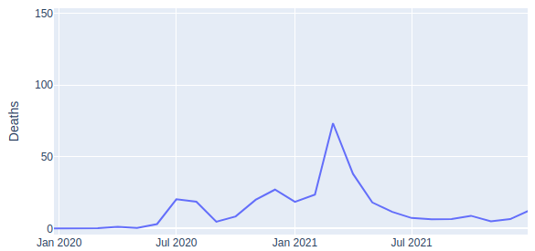
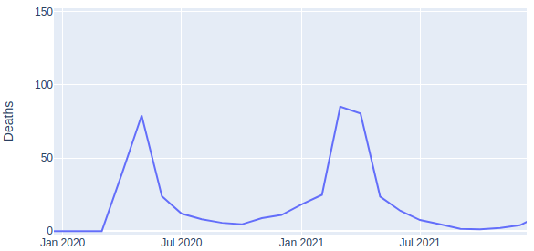
Dashboard: COVID-19
Florianópolis vs Cuiabá
Florianópolis - SC
Cuiabá - MT

Slide 56
Contents
1 - Introduction
2 - Background
3 - Related Work
4 - Methodology
5 - Results
6 - Discussion
7 - Conclusion

Slide 57
Seasonality
EDi outperforms EWDi
EDi is similar to PTR
3 distinct clustering regions are associated with climate:
Cluster 1 in Tropical zone
Cluster 2 in a mix of Tropical and Dry
Cluster 3 in Temperate
Roraima, at the North of the amazon, is a prominent exception
Southern states have higher HDI -> better housing and infrastructure
Seasonality difference cannot be due to infrastructure

Slide 58
Seasonality Factors
Dew Point Temperature is a combination of Temperature and Humidity
Temperature influences:
Blood pressure (vasoconstriction and vasodilation)
Indoor gathering -> colds/flu
Respiratory efficiency
Humidity influences:
Body’s ability to cool itself
Allergies due to mold growth
Respiratory efficiency

Slide 59
Contents
1 - Introduction
2 - Background
3 - Related Work
4 - Methodology
5 - Results
6 - Discussion
7 - Conclusion

Slide 60
Answers to Research Questions
Q1: How can we effectively measure the seasonal variation in mortality in heterogeneous contexts?
Both the EDi and PTR are solid choices that work well for various contexts.
EDi is simpler and easily reproducible, good for comparing different studies, and evaluating contributing causes of death.
PTR is more informative and mathematically robust, good for a thorough local analysis

Slide 61
Answers to Research Questions
Q2: What is the seasonal variation in mortality in Brazil and how does it vary geographically and by cause?
Three main groups, and mostly due to circulatory and respiratory diseases
North: smaller seasonality, early-autumn peak, late-spring trough
Center: smaller seasonality, early-winter peak, mid-spring trough
South: larger seasonality, early-winter peak, late-summer trough

Slide 62
Answers to Research Questions
Q3: What environmental factors are more associated with that seasonality?
Dew point Temperature (DPT) is the main factor, due to combining Dry Bulb Temperature and Relative Humidity.
São Paulo and Rio de Janeiro: mortality is negatively associated with DPT, mostly due to Dry Bulb Temperature
Fortaleza: mortality is positively associated with DPT, mostly due to Relative Humidity

Slide 63
Contributions
New seasonality metric called EDi
Comparison of metrics in Brazil
Dew Point Temperature association with mortality
Interactive Dashboard

Slide 64
Limitations
Limited analysis of socioeconomic factors
Reliability of medical coding and weather data
Subjective choices for PTR and EDVLi calculation

Slide 65
Future Work
Enhance Climate vs. Mortality analysis
More and better climate data
Machine Learning to predict seasonality
Modeling broad mortality instead of just seasonality
Mortality variation across states
Disparities in mortality by race and gender
Improve dashboard

Slide 66
Victor Foscarini Almeida
<victor.foscarini@ime.usp.br>
interscity.org/health

Slide 67
