Slide 1
CACIC:
Trusted Access Control Using Enclaves to Data in Internet of Things Clouds
Guilherme A. Thomaz, Matheus B. Guerra and Miguel Elias M. Campista
www.gta.ufrj.br
Poli – Dept. de Eng. Eletrônica e de Computação
COPPE – Programa de Engenharia Elétrica
Universidade Federal do Rio de Janeiro

Slide 2
1 Introduction and scenario

Slide 3
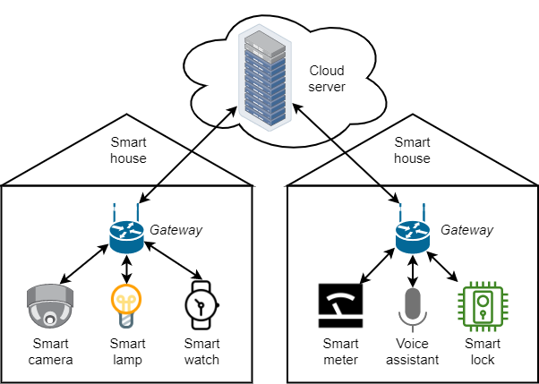
Introduction and scenario
Internet of Things devices collect data which are processed in the cloud.
“Unlock the door”

Slide 4
Introduction and scenario
Users lose control over what is done with their data when the cloud is malicious.
Health condition
Voice recordings
Security images
Localization
Vacant time
Consumption patterns

Slide 5
Introduction and scenario
Solution:
Trusted Access Control Using Enclaves to Data in Internet of Things Clouds
Protects data processing
Manage cryptographic keys
Protect database
Client customizes access policies
It does not depend on the DB and the sensor.

Slide 6
Introduction and scenario
Security requirements:
Privacy
Integrity
Authentication
Access control
The attacker can:
have privileged access
infect the OS
intercept network
manipulate network
Attacker cannot:
access residences
break encryptions
access integrated circuit

Slide 7
2 Trusted computing

Slide 8
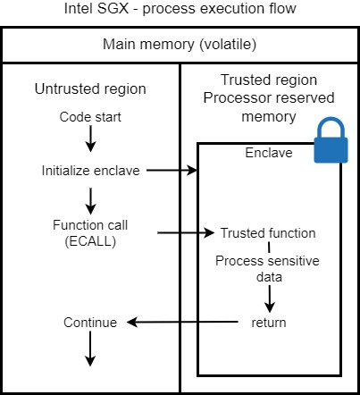
Trusted computing
Trusted computing technologies provide security by hardware resources.
Enclaves are isolated, encrypted regions in memory, accessed with special instructions.

Slide 9
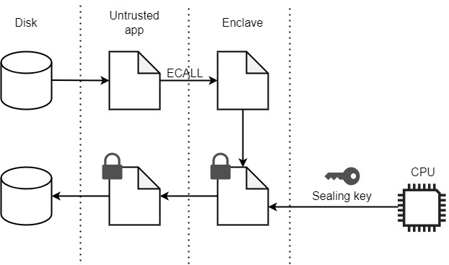
Trusted computing
To store persistent data, enclaves can seal it with a CPU-unique key.

Slide 10
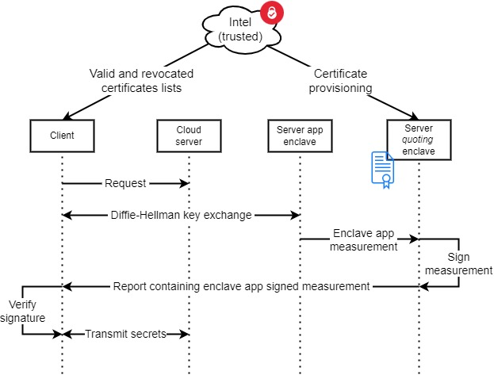
Trusted computing
Attestation proves that the platform is secure and authentic for data to be transferred

Slide 11
3 Architecture

Slide 12
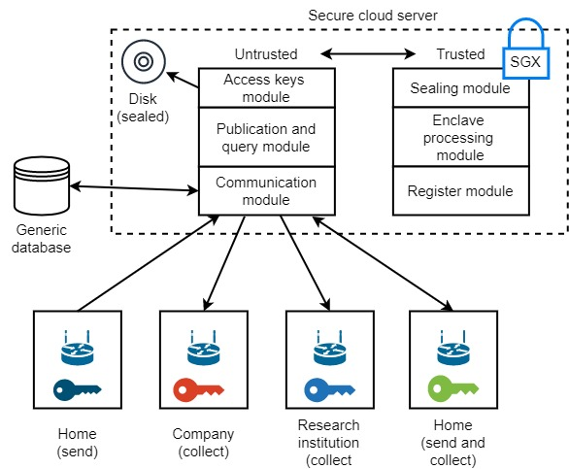
Architecture

Slide 13
Client access point attests to the server and they establish a communication key (CC).

Slide 14
Access point sends encrypted data and server identifies origin by public key (pub)
Access permissions

Slide 15
Data is only decrypted in the enclave, processed in an isolated environment and encrypted with the storage key (CA)

Slide 16
Data retrieved from the database is always encrypted and can only be decrypted in the enclave.
Comando para BD

Slide 17
Access permissions, stored along with the data, are verified within the enclave before the data is made available.

Slide 18
4 Results

Slide 19
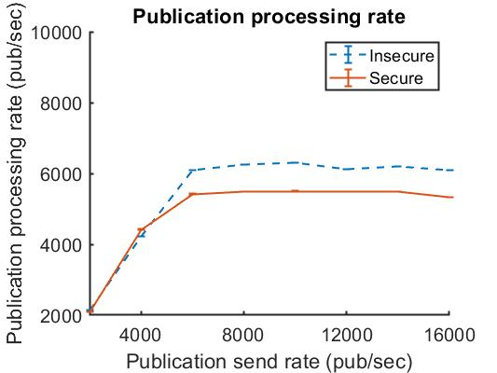
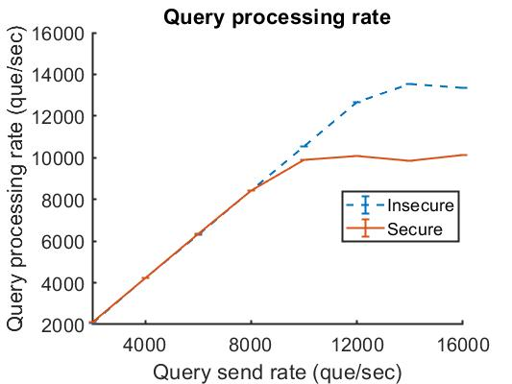
Results
Process more 5k (10k) concurrent publications/queries

Slide 20
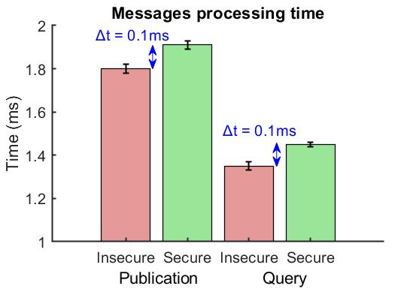
Results
Inserts a delay of 0.1ms in the processing of requests

Slide 21
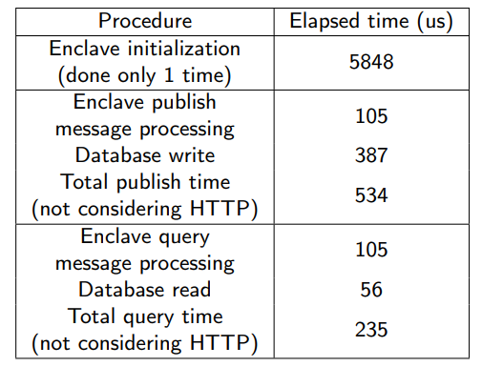
Results
One enclave supports multiple threads (reducing the initialization time)
HTTP message processing and disk writing produce a big overhead

Slide 22
5 Conclusions

Slide 23
Conclusions
Solution:
Trusted Access Control Using Enclaves to Data in Internet of Things Clouds
Protects data processing
Manage cryptographic keys
protect database
Client customizes access policies
It does not depend on the DB and the sensor.
Using isolated enclaves in memory
Client and server match key in registry
Data is encrypted by hardware key
Permissions sent and verified in enclaves
Any processing on any data

Slide 24
www.gta.ufrj.br

