Slide 1
CACIC
Trusted Access Control Using Enclaves to Data in Internet of Things Clouds
Guilherme A. Thomaz, Matheus B. Guerra and Miguel Elias M. Campista
www.gta.ufrj.br
Poli – Dept. de Eng. Eletrônica e de Computação
COPPE – Programa de Engenharia Elétrica
Universidade Federal do Rio de Janeiro

Slide 2
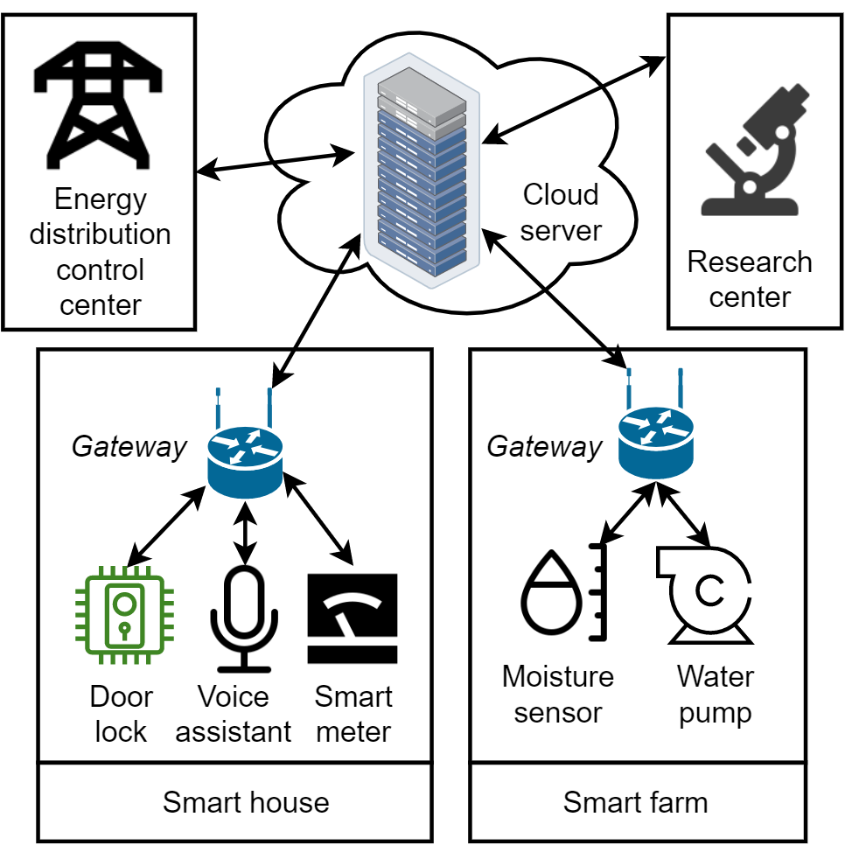
Introduction and Scenario
“Unlock the door”
Health condition
Voice recordings
Security images
Localization
Vacant time
Consumption patterns

Slide 3
Solution: CACIC
Protects data processing and storage
Client customizes access policies
Imperceptible overhead to clients
The attacker can have privileged access to the cloud
Attacker cannot access sensors and edge

Slide 4
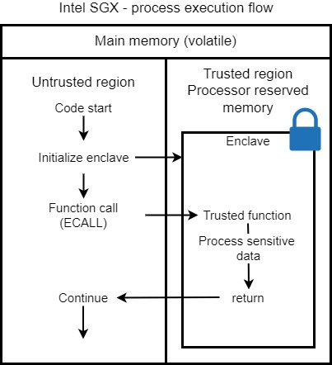
Trusted Computing (Secure Hardware)
Software Guard Extensions provide special instructions to isolate data in memory enclaves.
Enclaves encrypt persistent data with CPU key and can attest to clients that it is secure

Slide 5
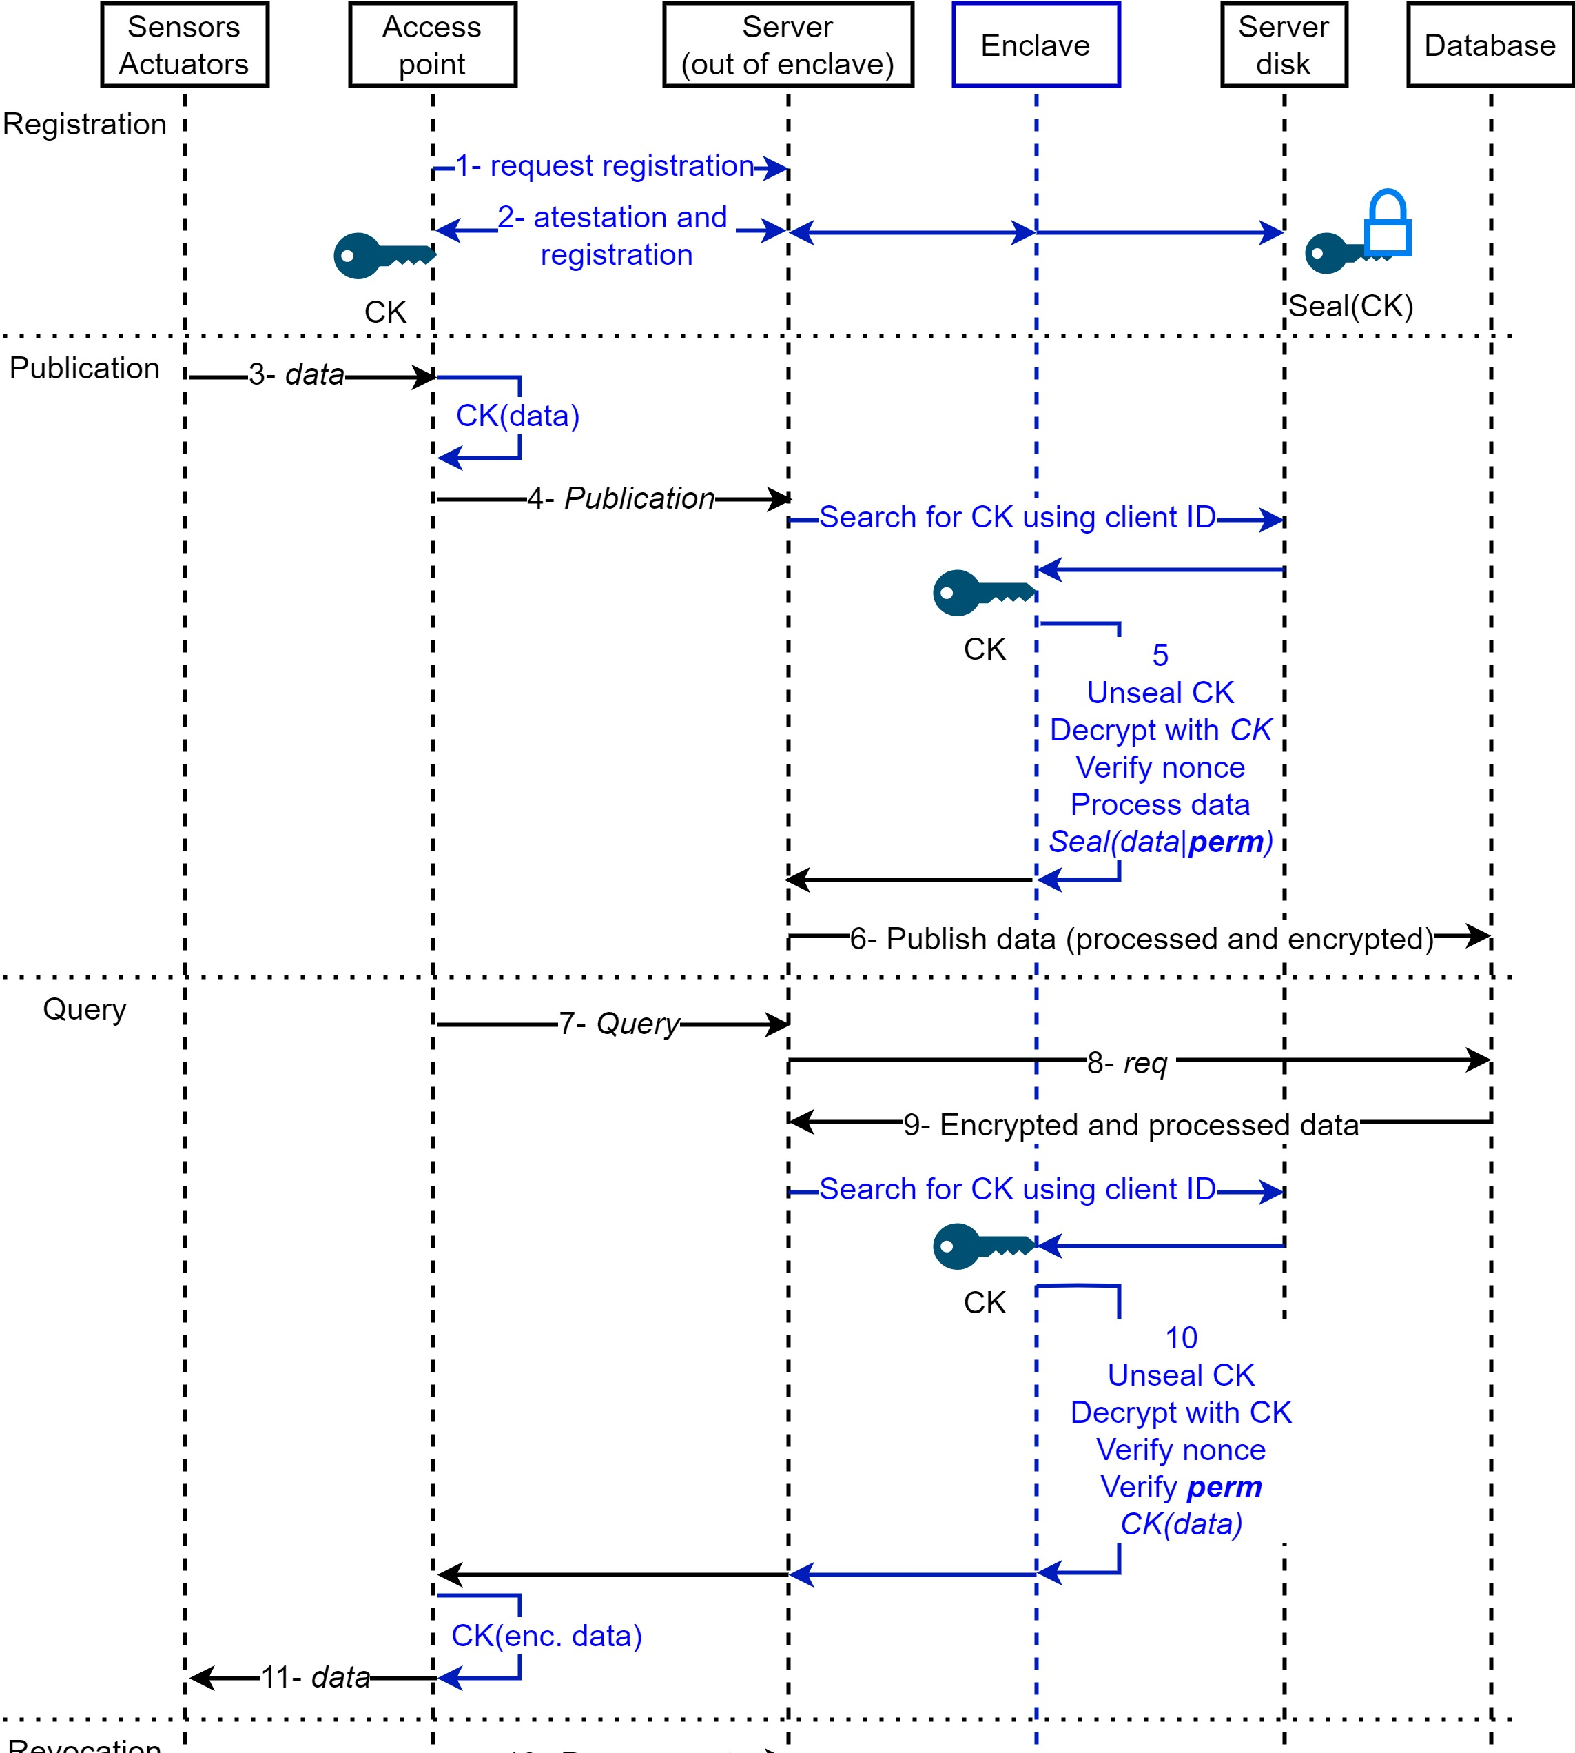
Attest security and share CK with enclave
Contains client ID, type and data encrypted with access permissions
Decrypted only inside enclave and encrypted before leaving enclave
Contains DB command
Access permissions stored with data verified inside enclave

Slide 6
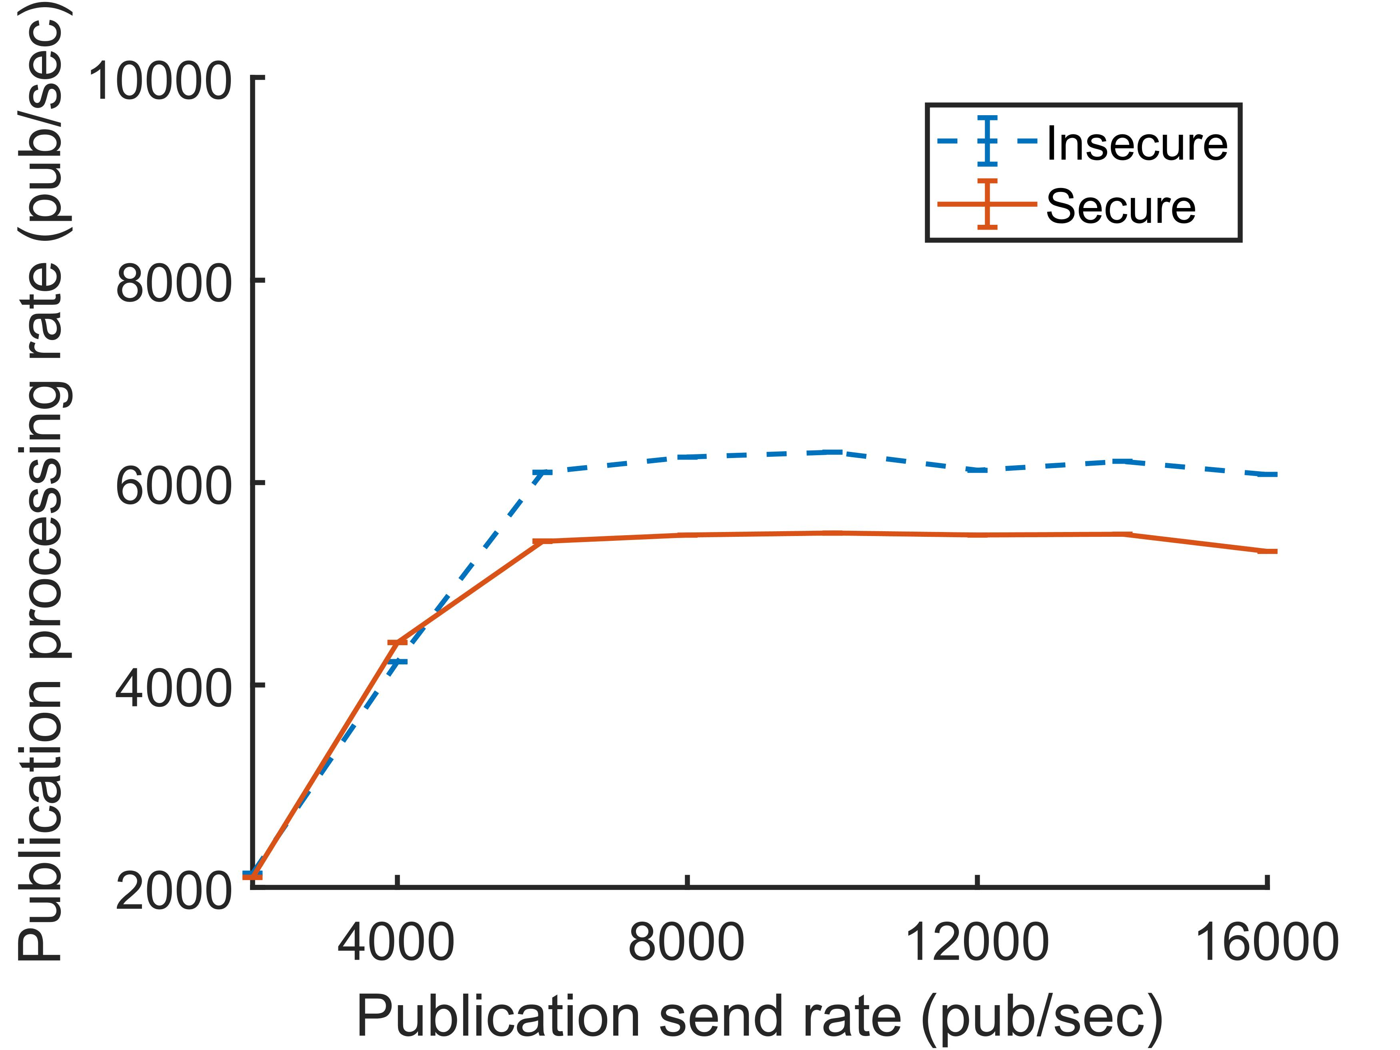
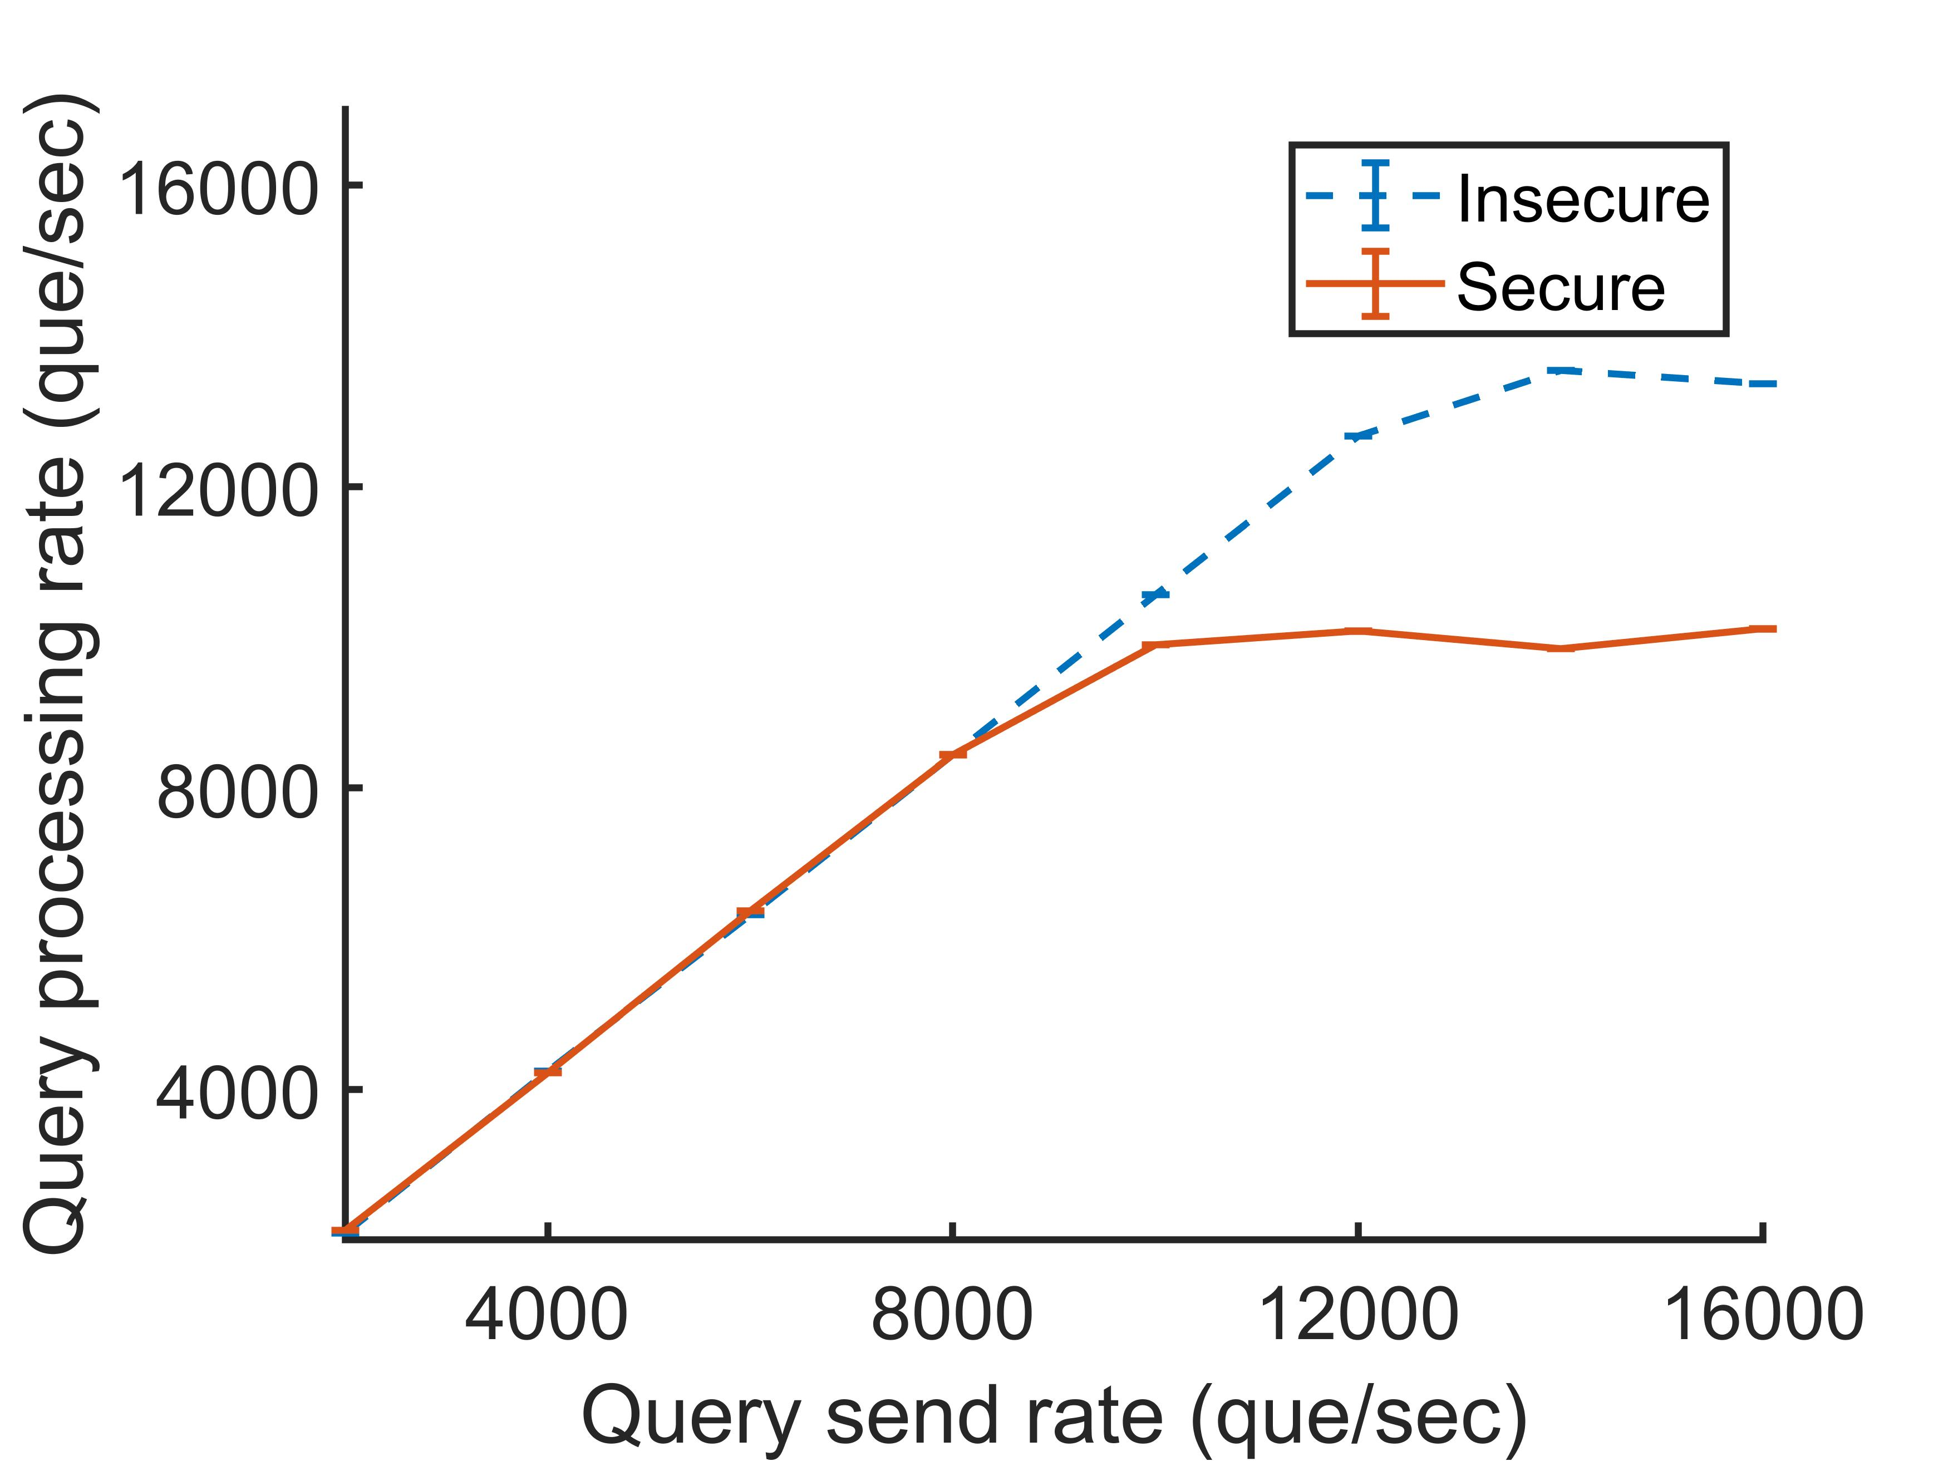
Scalability

Slide 7
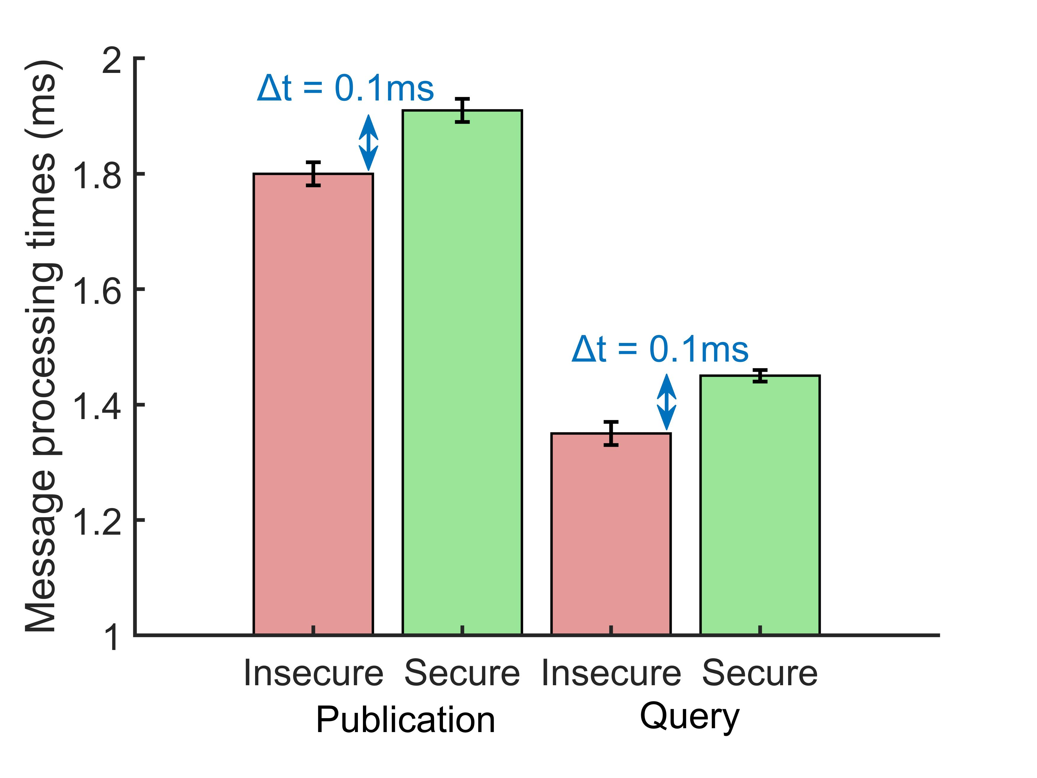
Latency

Slide 8
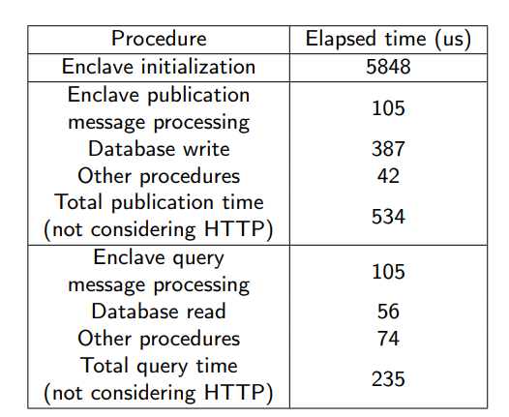
Microbenchmark

Slide 9
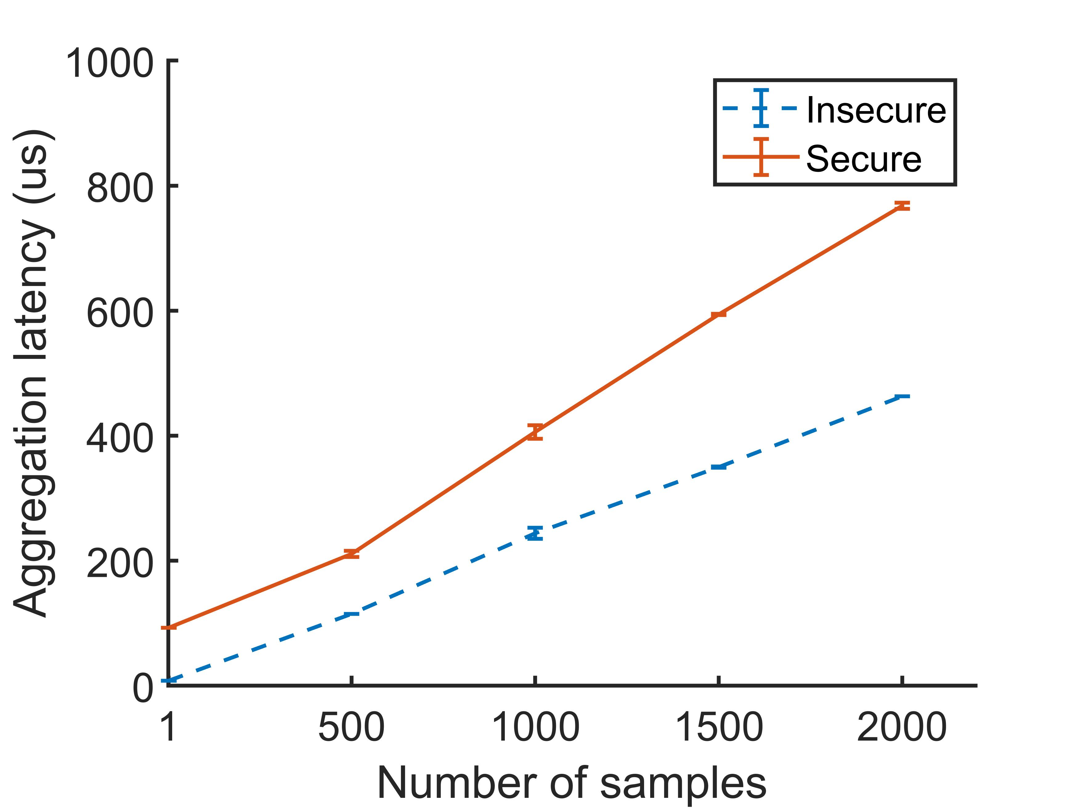
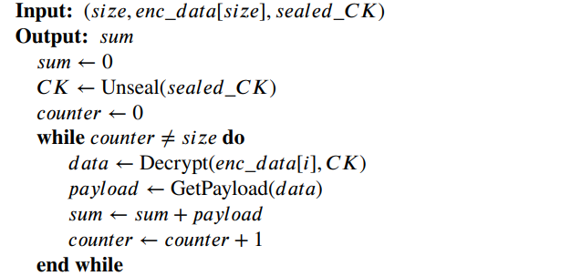
Use-case: Aggregation

Slide 10
Conclusion and Next Steps
What we have achieved
Security even if who controls the server is malicious
Enforce clients’ control policies
Optimized performance
Enclaves viability for practical processing tasks
Generic architecture
What needs to be done yet
Protect devices and edge
Implement deep learning and federated learning with enclaves
Code publication system
Distributed processing with enclaves

Slide 11
Publications
[1] G. A. Thomaz, M. B. Guerra, M. Sammarco, M. E. M. Campista, Cacic: Controle de acesso confiável usando enclaves a dados em nuvem da internet das coisas, in: Anais do XL Simpósio Brasileiro de Redes de Computadores e Sistemas Distribuídos, SBC, 2022, pp. 573–586. doi:10.5753/sbrc.2022.222377.
Submitted for Ad Hoc Networks Journal (Elsevier):
[2] G. A. Thomaz, M. B. Guerra, M. Sammarco, M. Detyniecki M. E. M. Campista, Tamper-proof Access Control for IoT Clouds Using Enclaves, in: Ad Hoc Networks Journal.

Slide 12
Acknowlogments
We also thank the late Dr.Ing. Otto C. M. B. Duarte for his essential support and tutoring that made this work possible

Slide 13
www.gta.ufrj.br

