Slide 1
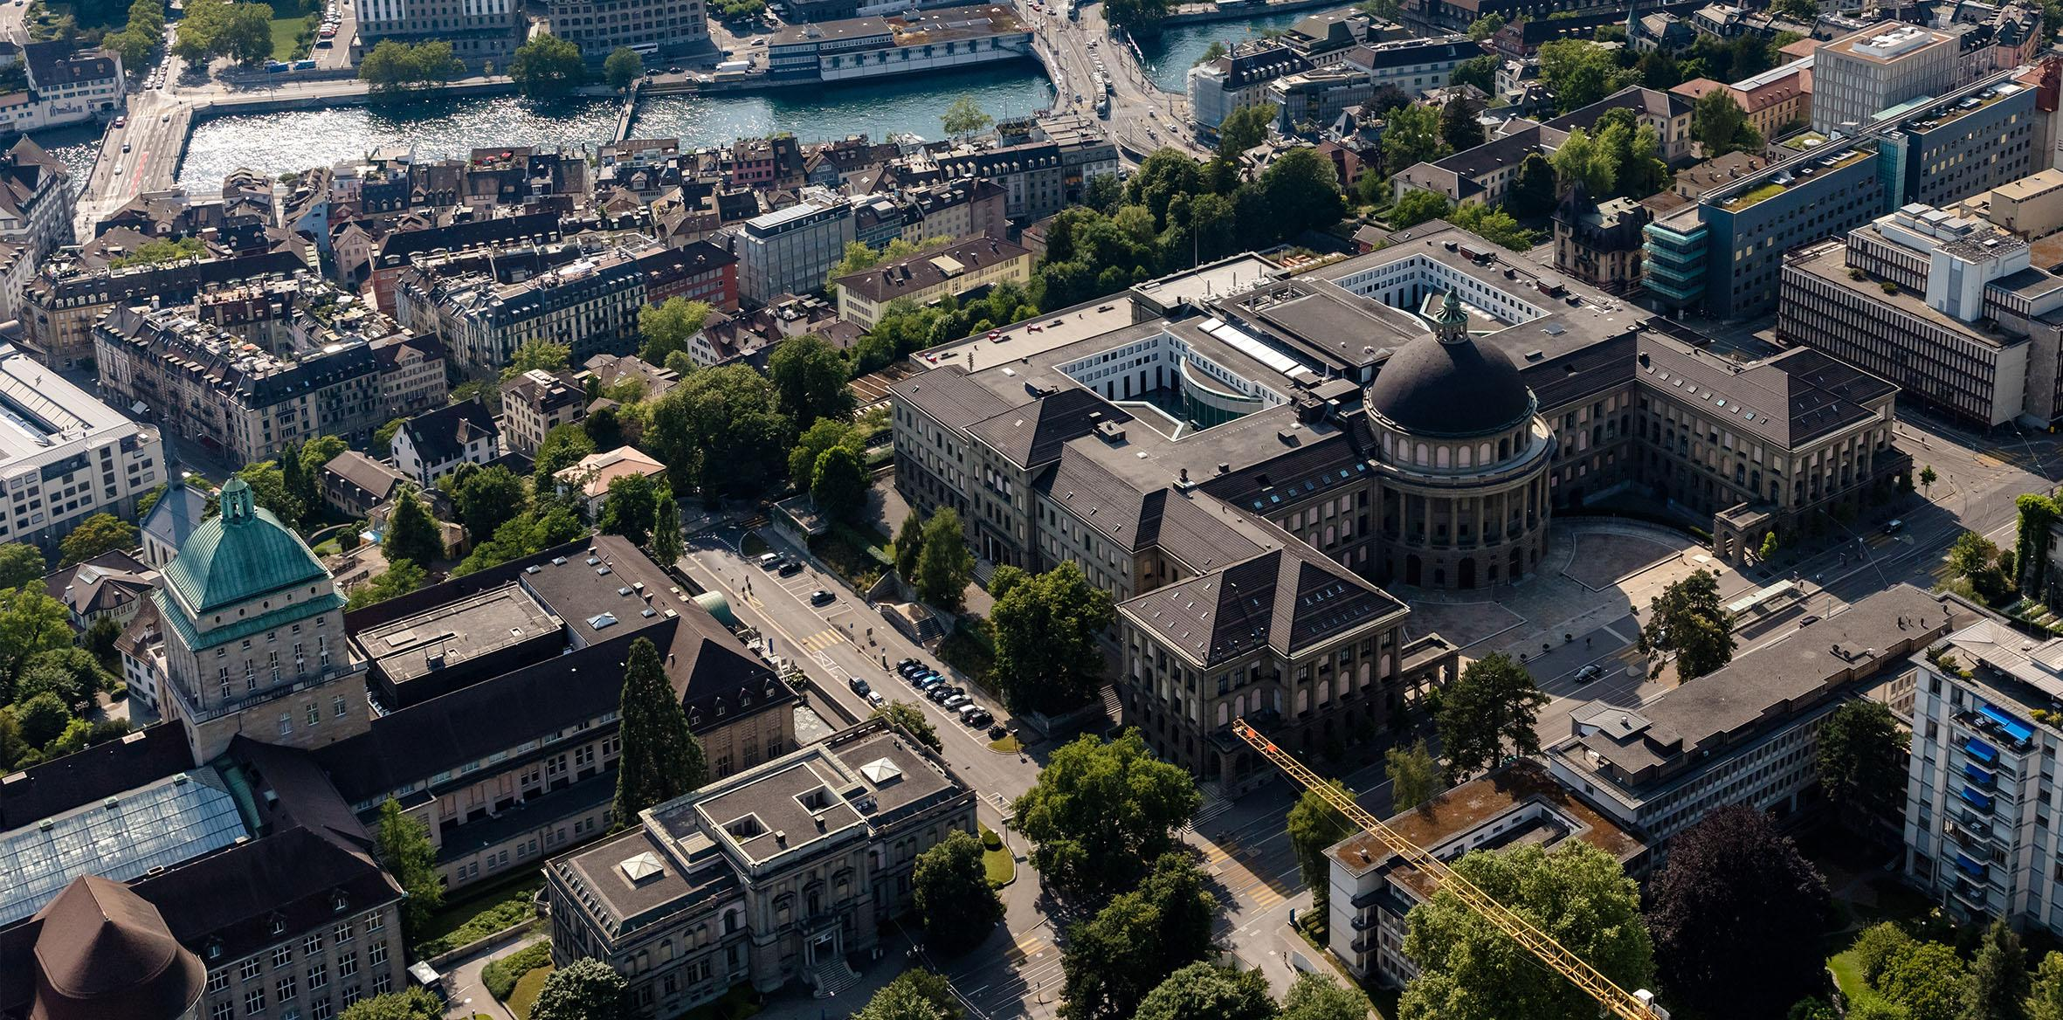
Spatial out-of-sample estimation of cycling OD matrices
Eduardo B. Falbel, Lucas M. de Freitas, Kay W. Axhausen, Raphael Camargo, Fabio Kon
08.05.2023
Notes:
Good morning, everyone.
My name is Eduardo Falbel, I’m a visiting bachelor student from the InterScity research group at the Universidade of Sao Paulo in Brazil.

Slide 2
Introduction
How can cities without cycling OD information make data-backed cycling infrastructure decisions?
E.g., bike-sharing stations, bike lanes, etc.
Our goal: to predict cycling OD matrices from urban data
09.05.2022
2
Notes:
How can …, such as building bss, bike lanes, or any other associated infrastructure Stemming from that, we sought to predict …, briefly this translates to creating models which are trained on cities with available cycling trip data and applied in cities without such data

Slide 3
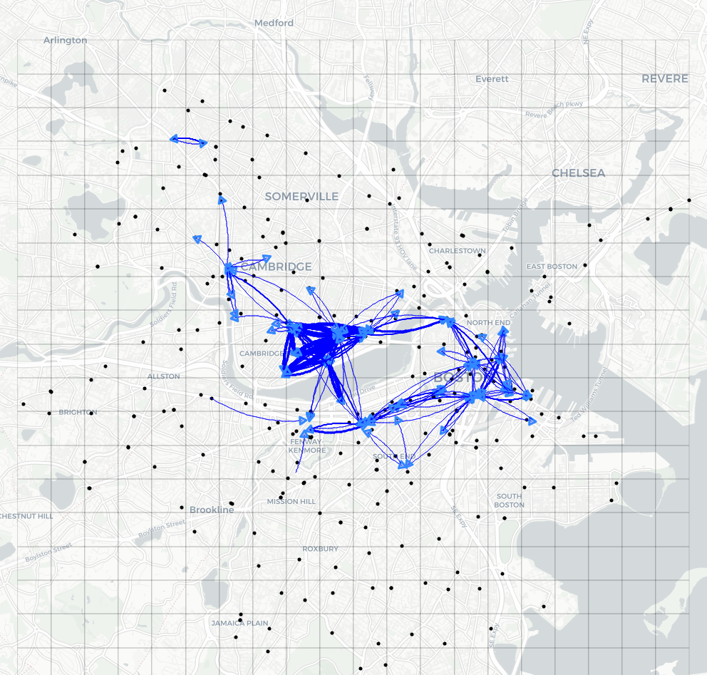
Cycling trip Data
Boston Blue Bikes bike-sharing system trip data (March 2018 - April 2019)
Abstract trips between stations to flows between cells
22.05.23
3
Notes:
And what data are we talking about? Well, for this project we used data from the …
This bss is station-based, but since we want to build generalizable models, we wanted to abstract this detail.
So we covered the city in a regular grid of cells and for each cell we aggregated the stations within as well as their corresponding trips.
So we abstracted trips between stations to flows between cells

Slide 4
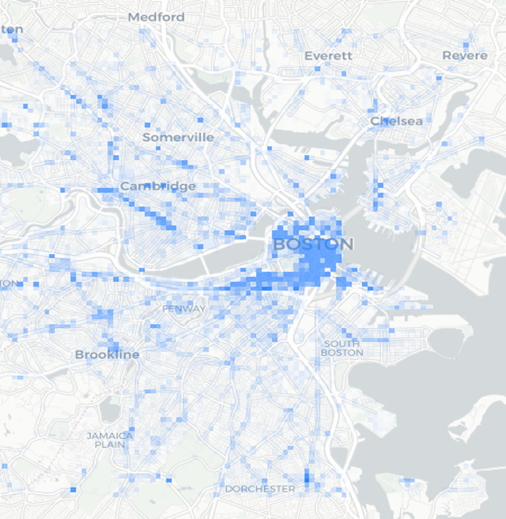
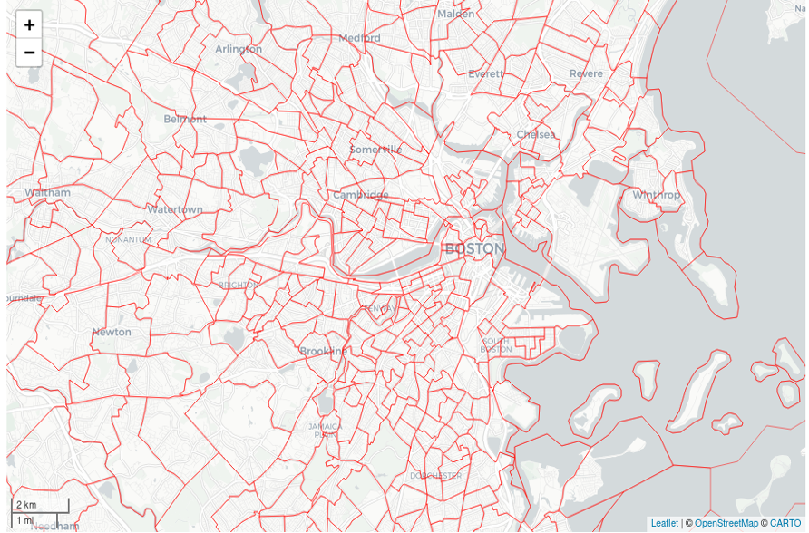
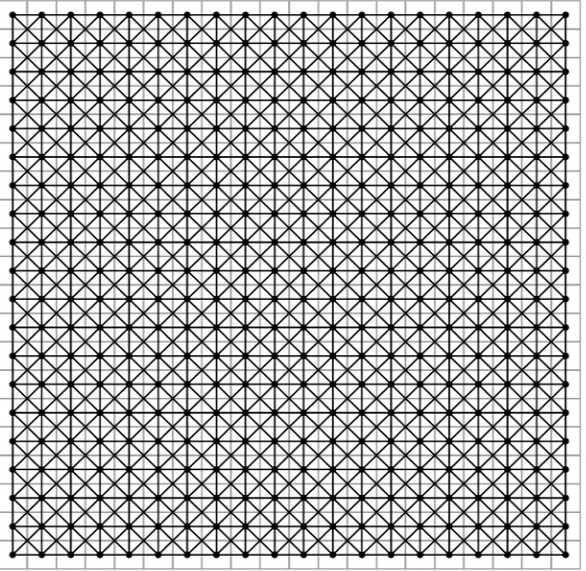
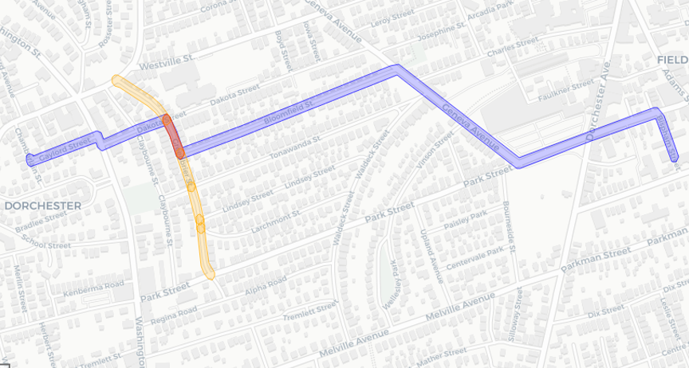
Contextual data
Google POI
US Census
Cycling infrastructure
Distance
22.05.23
4
Notes:
The urban data I mentioned before is what we call the contextual data, meaning the explanatory variables we used for the models

Slide 5
Models
Catboost – gradient boosted regression trees (machine learning)
“Aspatial” model – log-linear gravity model
Spatial Lag model (SLA) – spatial econometric interaction model
09.05.2022
5

Slide 6
Spatial Econometric Interaction Models
“[assuming independence between observations] seems heroic for […] spatial problems.” [LeSage and Pace, 2008]
Model specification (Spatial Lag Model):
$$y=p_{d}W_{d}y+p_{o}W_{o}y+p_{w}W_{w}y+β_{d}X_{d}+β_{o}X_{o}+γd+ε$$
[LeSage and Pace, 2008] LeSage, J. P. and Pace, R. K. (2008) Spatial econometric modeling of origin-destination flows*, Journal of Regional Science, 48(5):941–967
22.05.23
6
Notes:
What are spatial e…? Essentially, they exist to fix a glaring issue with models like the gravity model, which is that they assume independence between observations.
As LeSage and Pace point, this seems heroic for spatial problems, which is why they proposed this new class of models
The specification of the model we used is given by the following equation.
It differs from the log-linear gravity model by these three terms in red, which are what we call spatial lags of the dependent variable.
So the Ys are the dependent variable, the Ws are spatial weights matrices and the rhos are the coefficients we want to estimate.
Spatial weights matrices are basically a way of describing which regions can influence another (the neighborhood) and how
Each of these terms attempts to capture a different kind of spatial dependence: destination-dependence, origin-dependence, and origin-to-destination-dependence.

Slide 7
Spatial Lag Model (SLA)
$$y=p_{d}W_{d}y+p_{o}W_{o}y+p_{w}W_{w}y+β_{d}X_{d}+β_{o}X_{o}+γd+ε$$
Trend-corrected predictor:
$$\hat{y}={(I−p_{d}W_{d}−p_{o}W_{o}−p_{w}W_{w})}^{−1}(β_{d}X_{d}+β_{o}X_{o}+γd)$$
22.05.23
7
Notes:
So as you can see from the model specification, we can’t directly use it for prediction, since we have the dependent variable on both sides of the equation.
What we want is to have it on only one side.
So, based on the existing literature, we came up with our own predictor, which we call the trend-corrected predictor

Slide 8
Methodology
22.05.23
8

Slide 9
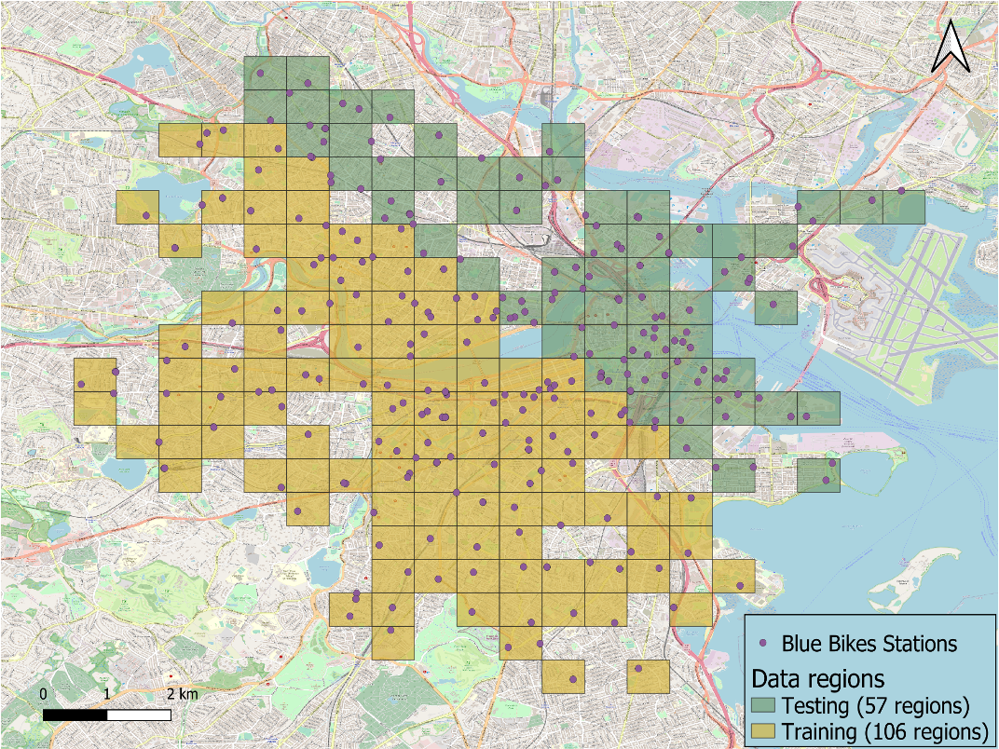
Train-test split
22.05.23
9
Notes:
Unlike what is typically done with ML train-test splits, for example, which are done so by randomly selecting data points,

Slide 10
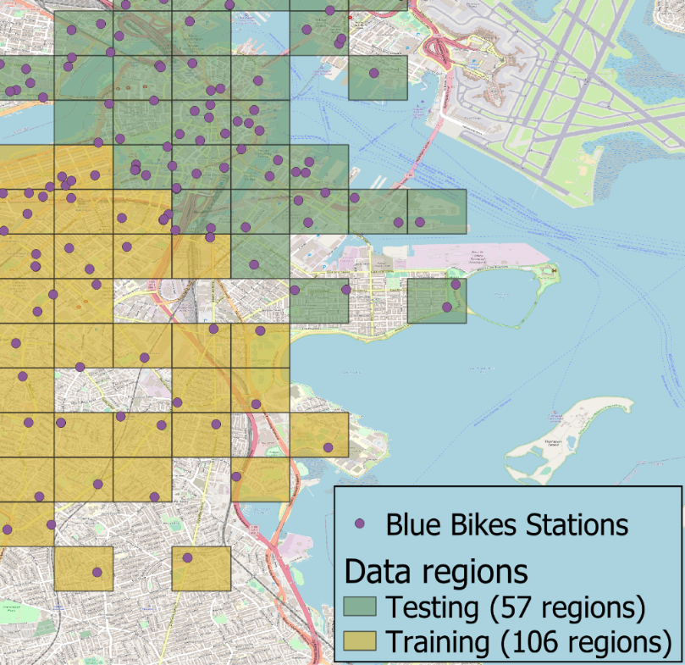
Weights matrix
8 Nearest Neighbors
Row-standardized
No distance-decay
22.05.23
10
Notes:
We then finally build our weights matrix for use with the models.
We chose to base it on nearest neighbours instead of contiguity, since otherwise we’d be left with islands (These isolated regions)
We also row-standardized it, as is the norm, so that the sum of the weights of a region’s neighbors would be 1
And finally we decided not to apply distance decay to the weights as to not mix with the effects of the distance as an explanatory variable

Slide 11
Results
22.05.23
11
Notes:
We’ll first talk about the in-sample results and then move on to the out-of-sample ones

Slide 12
Root Mean Squared Error
$$RMSE=\sqrt{\frac{\sum{(y_{pred}−y_{obs})^{2}}}{N}}$$
Model | RMSE
Trend-corrected (SLA) | 229.4
Aspatial | 255.0
Catboost (ML) | 268.2
22.05.23
12
Notes:
We’ll first talk about the in-sample results and then move on to the out-of-sample ones

Slide 13
Quartiles
Predicted | 0 | 1 | 2 | 3 | All
Observed
0 | 6 | 14 | 12 | 5 | 37
1 | 4 | 13 | 33 | 26 | 76
2 | 5 | 11 | 65 | 93 | 174
3 | 1 | 13 | 108 | 2840 | 2962
All | 16 | 51 | 218 | 2964 | 3249
Based on the # of trips per flow
Each quartile contains 25% of trips
⬆️ Catboost (ML)
Trend-corrected (SLA) ⬇️
Aspatial ⬇️
Predicted | 0 | 1 | 2 | 3 | All
Observed
0 | 12 | 11 | 10 | 4 | 37
1 | 9 | 25 | 28 | 14 | 76
2 | 12 | 22 | 70 | 70 | 174
3 | 7 | 33 | 163 | 2759 | 2962
All | 40 | 91 | 271 | 2847 | 3249
Predicted | 0 | 1 | 2 | 3 | All
Observed
0 | 4 | 9 | 13 | 11 | 37
1 | 2 | 8 | 37 | 29 | 76
2 | 4 | 9 | 56 | 105 | 174
3 | 2 | 6 | 86 | 2868 | 2962
All | 12 | 32 | 192 | 3013 | 3249
22.05.23
13
Notes:
We’ll first talk about the in-sample results and then move on to the out-of-sample ones

Slide 14
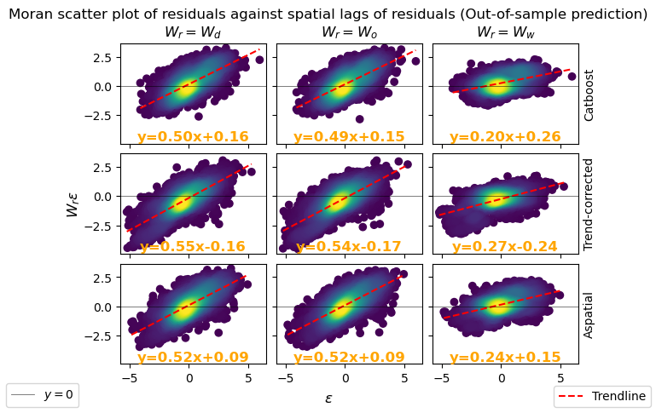
Residual analysis
22.05.23
14
Notes:
We’ll first talk about the in-sample results and then move on to the out-of-sample ones

Slide 15
Conclusion
We ARE able to predict cycling flows in cities with a reasonable degree of accuracy
For now, the trend-corrected (SLA) predictor was the best
There is ample room for improving our ML model
22.05.23
15

Slide 16
Ongoing and Future work
Why does the trend-corrected predictor (SLA model) fail to capture spatial dependence?
Apply hyper-parameter tuning to ML model
Develop generalizable model (to other cities)
16

Slide 17
Eduardo Bobrow Falbel – eduardo.falbel@usp.br
Institute for Transport Planning and Systems (IVT) - ETH Zurich
InterSCity – University of Sao Paulo
This research was funded in part by the São Paulo Research Foundation (FAPESP), processes 2022/06328-7 and 2021/09285-4.
This research is part of the INCT of the Future Internet for Smart Cities funded by CNPq proc. 465446/2014-0, Coordenação de Aperfeiçoamento de Pessoal de Nível Superior – Brasil (CAPES) – Finance Code 001, FAPESP proc. 14/50937-1, and FAPESP proc. 15/24485-9.

