Slide 1
The 10th International Conference on Future Internet of Things and
Cloud (FiCloud 2023)
Drone Edge Management System (DREMS):
Sequencing Drone Takeoff and Landing
Lucas de Paula Soares¹
Fabíola M. C. de Oliveira²
Carlos A. Kamienski²
Luiz F. Bittencourt¹
¹ University of Campinas (UNICAMP)
² Federal University of ABC (UFABC)
Notes:
I am Lucas de Paula Soares, and the topic of the presentation is the Drone Edge Management System (DREMS), sequencing drone takeoff and landing.
I’ve been working on this project alongside Fabiola de Oliveira, Carlos Kamienski and Luiz Bittencourt

Slide 2
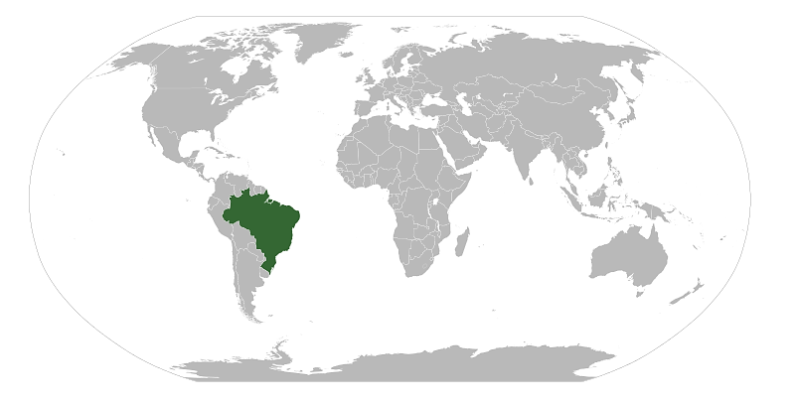
Notes:
I'm from Brazil, Sao Paulo State and currently an undergrad student of UNICAMP.
(it's my first presentation at a international conference)

Slide 3
Introduction – drones for delivery services
Drone delivery services are being increasingly considered by numerous businesses¹
online companies, supermarkets, drugstores, and restaurants
Reduces carbon emissions and traffic congestion in urban areas
Delivery
Delivery
Notes:
The use of UAVs, specifically drones, is now common in smart cities and farms.
They can provide numerous services, including fire prevention, surveillance, and delivery of goods and food.
Business, including online companies, supermarkets, drugstores, and restaurants, are increasingly considering drone delivery
to provide fast customer service while reducing carbon emissions and traffic congestion in urban areas.

Slide 4
Introduction – delivery services scenario
Higher density of drones coming from multiple directions, taking off and landing simultaneously in a 3D space
Main challenge: collision avoidance in different flight stages, such as takeoff, landing and cruise trips
Delivery
Delivery
D
Delivery
Delivery
Distribution center
Notes:
In this study, we consider a simulated scenario with a large number of drones performing a point-to-point delivery and returning to the distribution center.
However, there are obstacles that must be addressed.
First and foremost, safety is a crucial requirement.
All collisions involving drones must be avoided in different flight stages, such as takeoff, landing and cruise trips

Slide 5
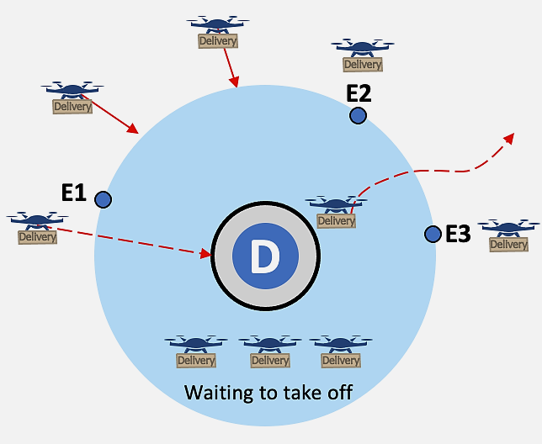
Introduction – delivery services scenario
Efficient landing and take-off is essential and requires sequencing of drones ready to depart or arrive at a dronepad.
Air traffic control strategies for aviation are typically inadequate for scenarios with higher densities of smaller autonomous aerial vehicles ²
Notes:
However, just as important as ensuring collision-free cruising is ensuring efficient and safe takeoff and landing, which requires sequencing drones that are ready to takeoff or land at a drone pad.
We could think of using existing air traffic control for aviation,
But they are typically inadequate with higher densities of smaller vehicles that take off and land in vertical infrastructures

Slide 6
Introduction – motivation
Studies involving heuristic strategy³, mixed-integer linear⁴ program, and models for eVTOL arrival control ⁵ consider only a small number of drones and aimed at eVTOL aircraft
Our work focuses on the use of edge infrastructure to support takeoff and landing in a high-density drone delivery scenario.
Objective: Minimize collisions during takeoffs and landings
Notes:
Many studies focus on traffic management and collision avoidance, involving heuristic strategy, mixed-integer linear program, and models for eVTOL arrival control
However, in the majority of these studies, only a small number of drones are considered, and are aimed at eVTOL aircraft, which are typically larger and associated with passengers and not with deliveries.
Whereas our research centers on utilizing edge infrastructure to support the takeoff and landing phases of drone deliveries in a high-density scenario.
With the primary objective of minimizing collisions during these stages

Slide 7
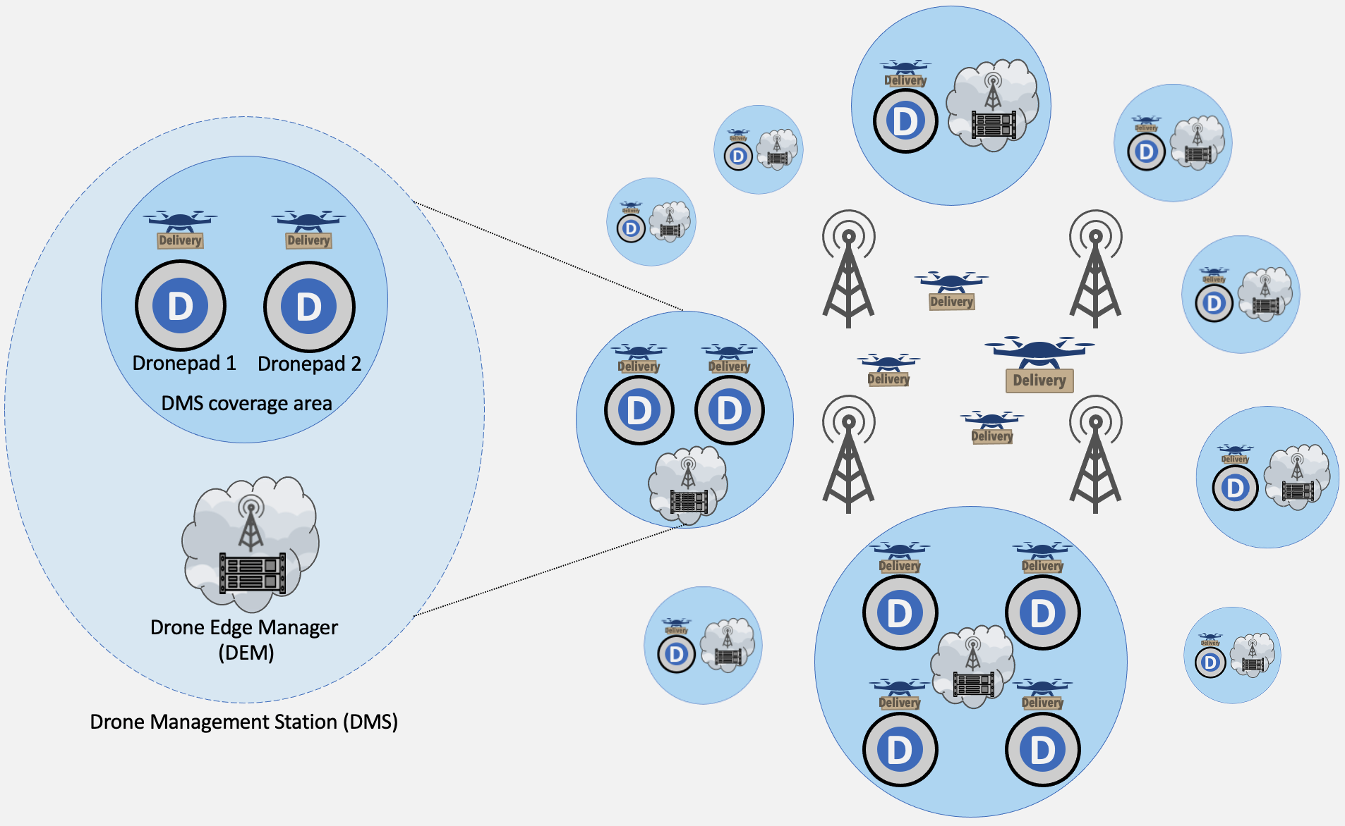
DREMS architecture
Notes:
For that purpose, we propose DREMS, which controls the takeoff and landing of drones at different Drone Management Stations - DMS.
Each DMS manages the drone activities for one or more organizations, which can include large distribution centers for online stores or various types, or smaller distribution centers for food delivery services, for example.
The figure shows DREMS with multiple DMS of different sizes.
(Make a pause longer here)

Slide 8
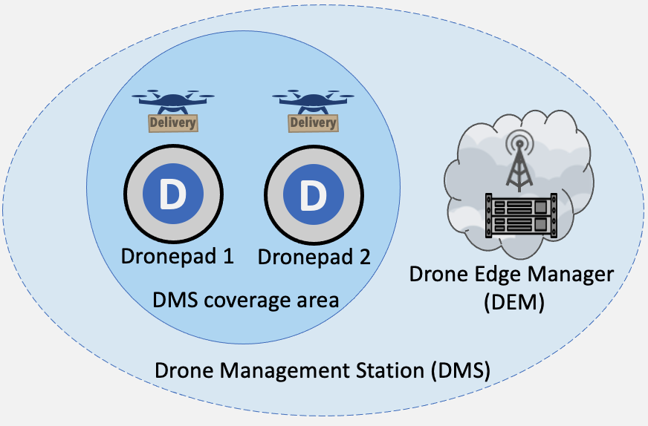
DREMS architecture
Drone Management Station (DMS)
Decide which drones are allowed take off and land within their coverage area and at what times
Drone Edge Manager (DEM)
Communication infrastructure (5G, 6G system)
Faster decision-making and lower latencies compared to a cloud-based network
Notes:
Each DMS has one or more dronepads and has a coverage area represented by a three-dimensional cylinder.
Here on the figure you see a superior view of the coverage area.
Within this area, they have the ability to detêrmine which drones are allowed to take off and land, and when.
We also propose drone edge managers - DEM - as components of a communication infrastructure, such as a 5G or 6G system, which provides edge computing capabilities.
This network enables faster decision-making processes for takeoff and landing, with lower latencies compared to a cloud-based network.

Slide 9
Delivery service phases
1) Receive a delivery order
2) Enqueue drones for each order
3) Take off from a dronepad to altitude h
4) Exit the DMS coverage area and fly to the delivery dronepad (cruise flight)
5) Land at the delivery dronepad and wait for t seconds so that the delivery occurs
6) Take off to altitude h to fly back
7) Fly back to the DMS coverage area (cruise flight)
8) Obtain clearance for landing
9) Land at the DMS dronepad
DREMS operates in phases 1, 2, 3, 8, and 9
Drones have autonomy in phases 4 to 7 with an anti-collision algorithm
Notes:
Our delivery service scenario encompasses nine phases:
First, Receive a delivery order
Second, Enqueue drones for each order
Third, Take off from a dronepad to a certain altitude
Four, Exit the DMS coverage area and fly to the delivery - in cruise flight
Five, Land at the delivery dronepad and wait so that the delivery occurs
Six, Take off to a certain altitude to fly back
Seven, Fly back to the DMS coverage area - in cruise flight -
Eigh, Obtain clearance for landing
and finally, Land at the DMS dronepad
DREMS operates in phases one , two, three, eight, and nine to support the drones competing for dronepads and prevent collisions within a DMS coverage area.
It is important to highlight that We assume that the drones have the autonomy to perform phases four, five, six, and seven with an anti-collision algorithm

Slide 10
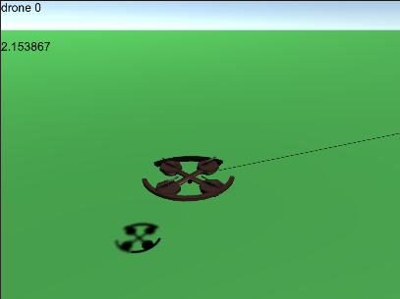
Methodology – drones and the environment
Drone dimensions of 2 m x 2 m x 0.5 m
Safety radius: 30m
Detection radius: 100m (LiDAR sensor)
SingleDrone anti-collision algorithm ⁶
Geometric approach
Turn at the smallest angle possible so that does not enter the safety radius, if that is impossible, detours vertically
Emergency detour: occurs in the case that the drone entered the safety detour
UTSim ⁷
Notes:
We implemented a version of DREMS in our modified drone simulator, based on UTSim, a drone simulator on Unity game engine.
The simulations assume each drone has dimensions of two per two per zero five meters, a safety radius of thirty meters, and a detection radius of one hundred meters.
This SingleDrone anti-collision algorithm is a geometric approach,
Based on the relative velocity vector concerning the first detected obstacle that could cause a collision, the algorithm determines if a horizontal detour is possible, turning at the smallest angle possible so that the drone does not enter the safety radius. If that is impossible, the drone detours vertically. During the detour, the drone halves its speed. The algorithm also includes an emergency detour when an obstacle invades the safety radius, causing the drone to stop and fly in its opposite direction.

Slide 11
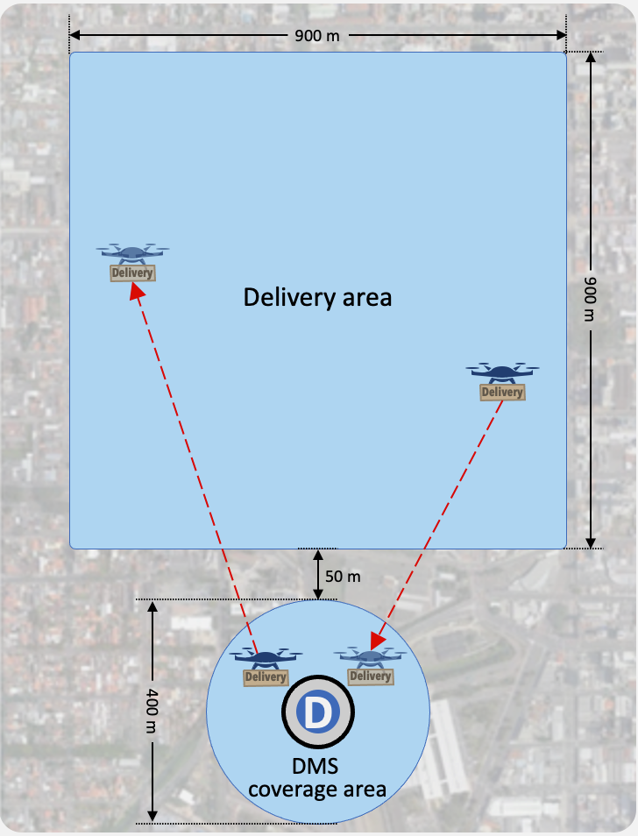
Methodology – drones and the environment
DMS with single dronepad
Represents a large distribution center further away from the urban area
Delivery orders arrive at DREMS at a rate according to the Poisson distribution, with four rates: 1, 2, 4, and 8 drones/min
Each delivery rate scenario is replicated 30 times
Notes:
We implemented a DMS with a single dronepad from which drones takeoff and land.
The simulation scenario includes a square delivery area and a circular coverage area of a DMS where DREMS and the DEM management operate.
We use 200 meters for the DMS coverage radius, as it represents a large distribution center further away from the urban area.
Delivery orders arrive at a rate according to the Poisson distribution, with four rates: 1, 2, 4, and 8 drones/min.
Each delivery rate scenario is replicated 30(thirty) times.

Slide 12
DREMS Sequencing Algorithm
Drone for takeoff
Drone for landing
T
L
L
T
time
$$t≥Ts$$
Guarantee a safety time between each landing or takeoff of at least Ts seconds
Sequencing queue: T, L, L, T First in, First out (FCFS) policy
Notes:
For this work, we implemented a simple sequencing approach to serve as a proof of concept of the DREMS architecture.
The main goal here is to guarantee a safety time between each landing or take-off of at least Ts seconds.
In this approach a single dynamic queue is used, which holds the sequence of drones. Whenever a drone requests to take off or land, it is added in a first-in, first-out queue.

Slide 13
DREMS Sequencing Algorithm
Drone at the queue for takeoff waits for clearance to takeoff
Returning drone receives a “hold position” message and waits at the same point it entered until it gets a “clear to land” message.
After $Ts$seconds, DREMS allows the next drone in the queue to use the dronepad
Limit of $n=6$ drones waiting to land around the coverage area, so that there is space for drones taking off to exit the DMS area.
Space saturated ($n>6$): a drone willing to land is sent $d=100m$ backward in the opposite direction it arrived. Then, it tries to approach again for landing
Notes:
A Drone in the queue for takeoff waits for clearance to takeoff
And when a returning drone arrives to land, a landing request is created and inserted in the queue.
The returning drone receives a “hold position” message and waits at the same point it entered until it gets a “clear to land” message.
After 𝑇𝑠 seconds, DREMS allows the next drone in the queue to use the dronepad.
There is a limit of 6 drones waiting to land around the coverage area.
Making it possible for a just-launched drone to takeoff according to its anti-collision algorithm. (in a way that it gets a space between the drones)
This limit aims at not crowding the coverage area with drones, so that the takeoff drone can fly to the outside of the coverage area
Suppose a drone arrives for landing, and there are already six drones around the DMS coverage area.
In that case, DREMS considers the space saturated, and the drone is sent one hundred meters backward in the opposite direction it arrived.
Then, it tries to approach again for landing (similar to the orbit message sent to airplanes by air traffic controllers).

Slide 14
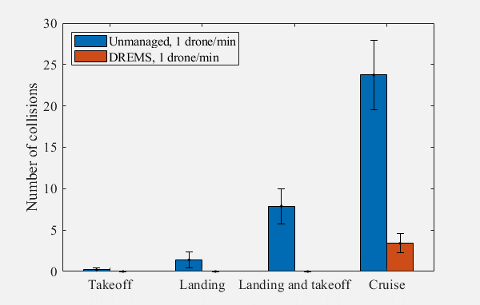
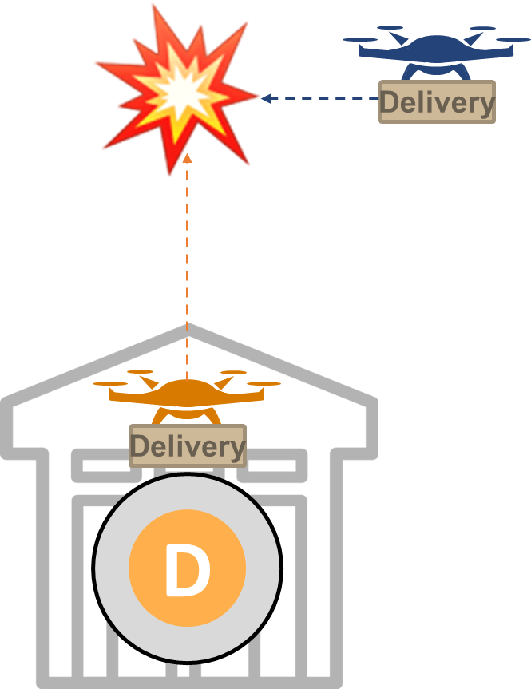
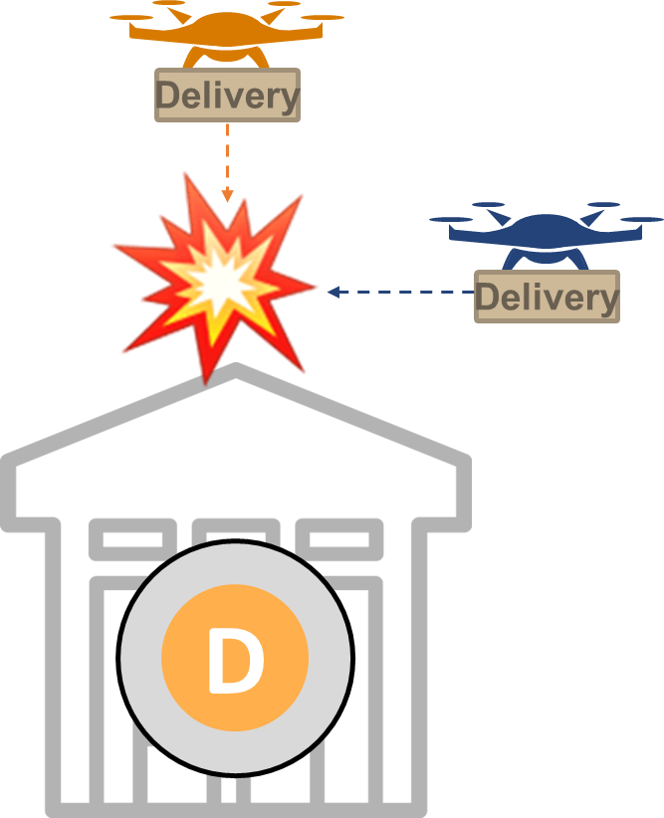
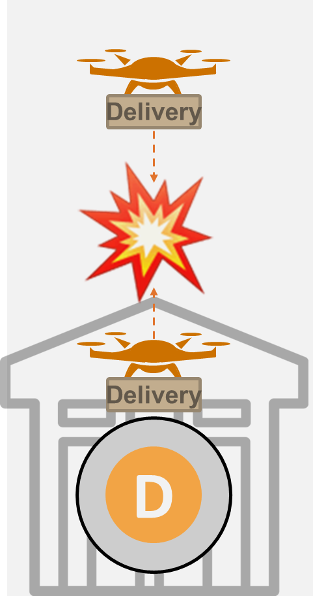
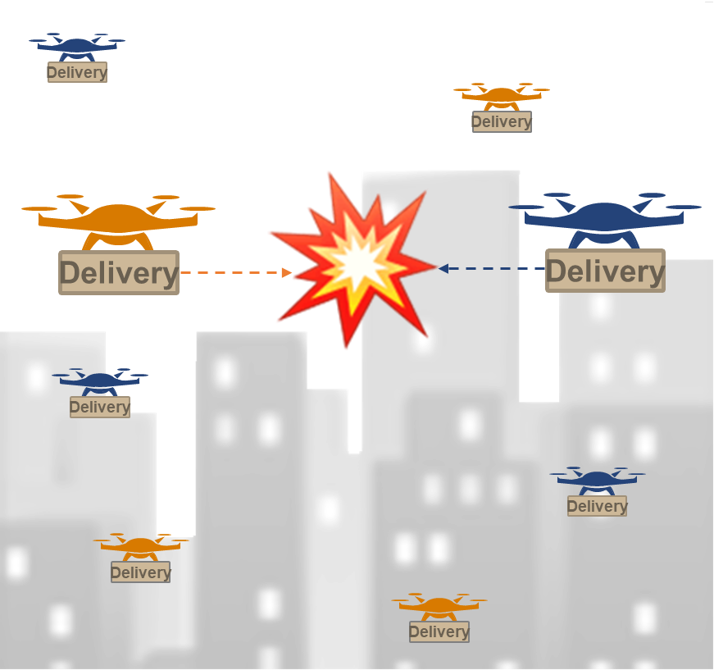
Results – Number of collisions
Number of collisions for different flight stages at a rate = 1 drones/min
Takeoff
Landing
Landing and Takeoff
Cruise
Notes:
Our results compare the ability of DREMS to reduce collisions during takeoff and landing with the unmanaged approach, where access to the drone pad is free to all drones, and they use the Single Drone anti-collision algorithm.
The Takeoff Collision happens when one drone is taking off and the other is in cruise flight.
Landing collision happens when one drone is landing and the other is cruising
Landing and takeoff happens when one is landing and other is taking off.
And finally Cruise collision when both drones are in cruise flight.
DREMS at the rate of 1 drone/min can eliminate the collisions in cases of Takeoff, Landing and Landing and Takeoff
Additionally, DREMS reduces the cruising collisions, although we did not design it aiming at that. This happens because DREMS controls better the airspace usage, limiting the density of drones

Slide 15
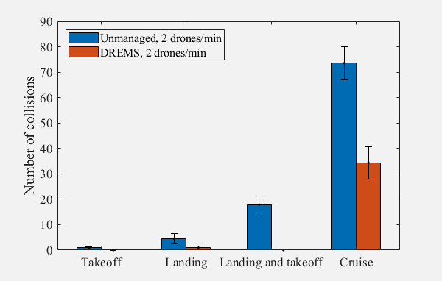
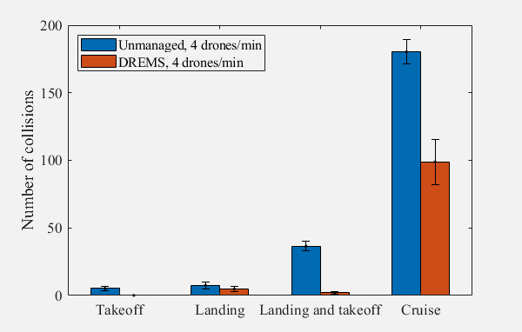
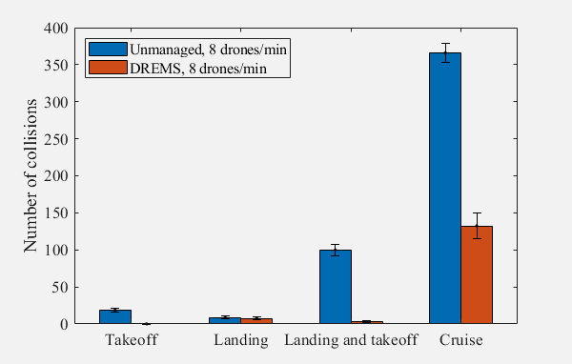
Results – Number of collisions
Number of collisions for different flight stages at a rate = 2 drones/min
Number of collisions for different flight stages at a rate = 4 drones/min
Number of collisions for different flight stages at a rate = 8 drones/min
Notes:
These are the results for the Poisson rates of two, four, and eight drones/min.
DREMS also reduces collisions in all flight stages.
However, some collisions still occur during landing or takeoff,
because a drone may detour too long within the DMS area and collide with another drone that is landing or taking off.

Slide 16
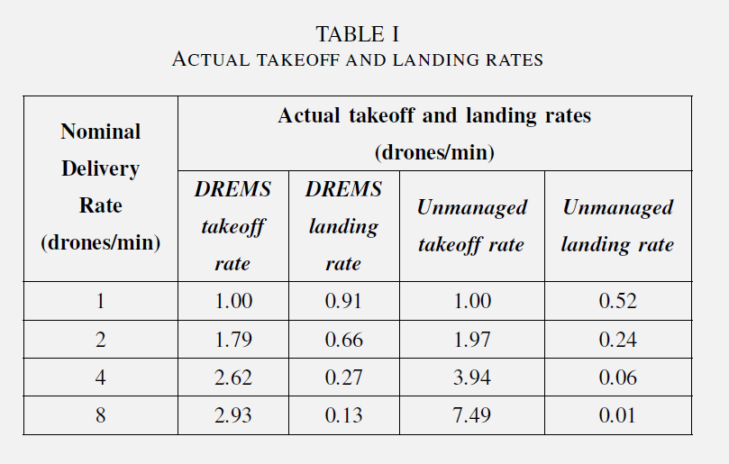
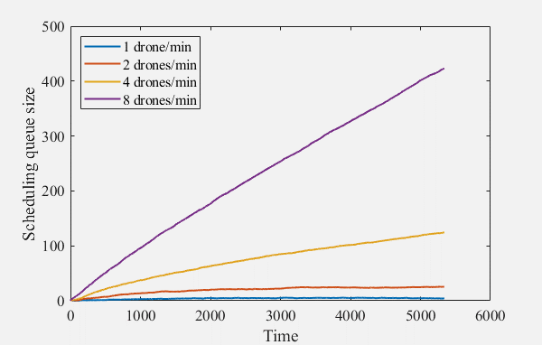
Results – sequencing queue over time
Notes:
This graph shows the sequencing queue over time, and Table I shows the actual takeoff and landing rates for each scenario.
Delivery orders are delayed for the nominal rates of four and eight drones/min as the queue overgrows over time,
since the order arrival rates are higher than the actual ability of DREMS to allow the drones to take off.
Different factors limit the actual takeoff and landing rate,
such as the safety time of 20 seconds, which limits them to three drones/min.
The rates of DREMS landing rate shown in Table I decrease as the nominal delivery rate increases, indicating an “on air” queue of drones waiting to land that have not yet entered the scheduling.
This “on air” queue consists of drones that try to approach the DMS but must fly back.
The actual takeoff rate for the unmanaged approach keeps up more closely to the nominal rate. The problem is that the number of collisions skyrockets for unmanaged as seen in the collision graphs

Slide 17
Conclusions
1) Safety is the fundamental requirement, as a zero collision approach is needed to encourage the adoption of this modality of delivery service.
2) A drone sequencing approach is necessary for the purpose of a delivery service with a high density of smaller drones
3) At lower order rates, DREMS system can achieve both safe and efficient requirements.
4) The unmanaged approach is catastrophic, resulting in high collision rates in different flight stages , even with an anti-collision algorithm.
Notes:
It is evident that any system that aims to sequence drone takeoff and landing must be safe and efficient.
And Safety is the fundamental requirement, as a zero collision approach is needed to encourage the adoption of this modality of delivery service.
Second, a drone sequencing approach is necessary for the purpose of a delivery service with a high density of smaller drones..
Third, at lower order rates, DREMS can achieve both requirements, virtually eliminating collisions
And that the unmanaged approach is catastrophic, resulting in high collision rates in different flight stages , even with an anti-collision algorithm.

Slide 18
Conclusions
5) Efficiency is also needed because lower rates will underutilize the dronepads and other ground infrastructure and reduce customer delivery rates.
6) There must be a balance between the scheduling of landings and takeoffs, with a higher priority assigned to landing, as it decreases the drone density in the airspace and the risk of running out of battery charge.
7) Implemented DREMS is a first step, leaving room for different strategies and algorithms to provide an adequate solution for this research challenge
Notes:
Efficiency is also needed because lower rates will underutilize the dronepads and other ground infrastructure and reduce customer delivery rates.
Sixth, there must be a balance between the scheduling of landings and takeoffs, with a higher priority assigned to landing,
as it decreases the drone density in the airspace and the risk of running out of battery charge.
Our implemented DREMS is a first step, leaving room for different strategies and algorithms to provide an adequate solution for this research challenge.

Slide 19
References
[1] B. Alkouz, B. Shahzaad, and A. Bouguettaya, “Service-based drone delivery,” in 2021 IEEE 7th International Conference on Collaboration and Internet Computing (CIC), pp. 68–76, IEEE, 2021.
[2] R. Rumba and A. Nikitenko, “The wild west of drones: A review on autonomous-UAV traffic-management,” in 2020 International conference on unmanned aircraft systems (ICUAS), pp. 1317–1322, IEEE, 2020.
[3] P. Pradeep and P. Wei, “Heuristic approach for arrival sequencing and scheduling for eVTOL aircraft in on-demand urban air mobility,” in 2018 IEEE/AIAA 37th Digital Avionics Systems Conference (DASC), pp. 1–7, IEEE, 2018.
[4] I. C. Kleinbekman, M. A. Mitici, and P. Wei, “eVTOL arrival sequencing and scheduling for on-demand urban air mobility,” in 2018 IEEE/AIAA 37th Digital Avionics Systems Conference (DASC), pp. 1–7, IEEE, 2018.
[5] K. Song and H. Yeo, “Development of optimal scheduling strategy and approach control model of multicopter VTOL aircraft for urban air mobility (UAM) operation,” Transportation research Part C: emerging technologies, vol. 128, p. 103181, 2021.

Slide 20
References
[6] F. M. C. de Oliveira, L. F. Bittencourt, R. A. C. Bianchi, and C. A. Kamienski, “Drones in the Big City: Autonomous Collision Avoidance for Aerial Delivery Services,” Manuscript submitted for publication, 2023.
[7] A. Al-Mousa, B. H. Sababha, N. Al-Madi, A. Barghouthi, and R. Younisse, “UTSim: A framework and simulator for UAV air traffic integration, control, and communication,” International Journal of Advanced Robotic Systems, vol. 16, no. 5, p. 1729881419870937, 2019

Slide 21
l201867@dac.unicamp.br
http://interscity.org
Notes:
Thank you for your attention and I'm open to questions

Slide 22
Collision Avoidance Approaches
Real-time performance
Dynamics of drones and obstacles
Dynamic environments
Outdoors
3D
Notes:
Better real-time performance
Dynamics of drones and obstacles
Dynamic environments
Better for outdoor environments
3D environments

Slide 23
Outline
Background
Related Work
Implementation
Experiments
Conclusion

Slide 24
Outline
Background
Related Work
Implementation
Experiments
Conclusion

Slide 25
Drone Edge Management System (DREMS):
Sequencing Drone Takeoff and Landing
Lucas de Paula Soares¹
Fabíola M. C. de Oliveira²
Carlos A. Kamienski²
Luiz F. Bittencourt¹
¹ University of Campinas (UNICAMP)
² Federal University of ABC (UFABC)
The 10th International Conference on Future Internet of Things and
Cloud (FiCloud 2023)

