Slide 1
IEEE International Smart Cities Conference (ISC2) September 7-10, 2021
Title: Feasibility study for detecting shallow landslides using IoT devices in smart cities
Authors: Alessandro Santiago dos Santos, Alessandra Corsi, Rynaldo Z. H. Almeida, Mauro Noda, Ícaro Gonçales, Rodrigo Ribeiro and Cezar Machado
Affiliation & email : Institute for Technological Research (IPT)
alesan@ipt.br

Slide 2
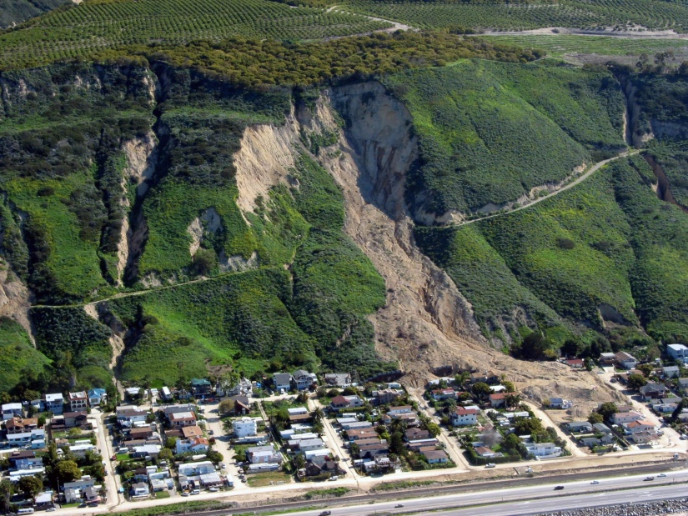
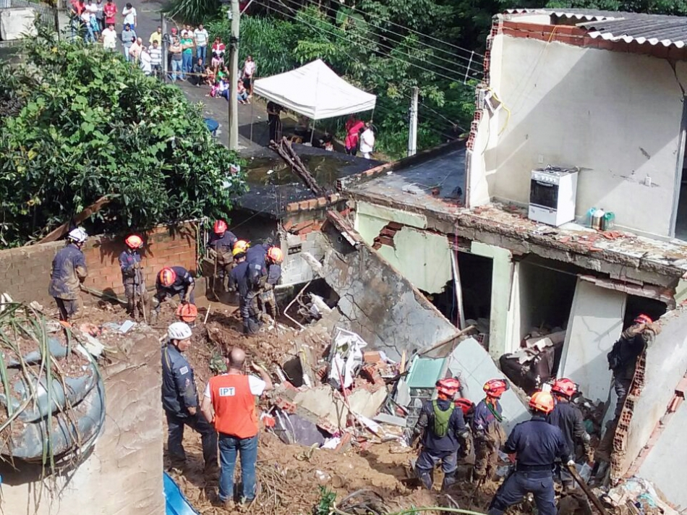
Shallow landslides
https://youtu.be/K9i3JyXocgI?t=70
Notes:
On slopes with a base of stones and rocks, covered by layers of earth. When water has fallen to the ground, it penetrates and soaks the ground, causing a downward force that can lead to landslide.

Slide 3
Sensors for landslide monitoring
Accelerometers are sensors more used to monitoring landslide in experimental projects
Knowledge base of inertial data about landslide are not common
Create a base with inertial data about the phenomenon
Source: (Mendrot and Stringhini,2019)
Notes:
In IoT scenarios, the accelerometers are more common sensors to use for monitoring landslides , However the knowledge base to understand this phenomenon are not common

Slide 4
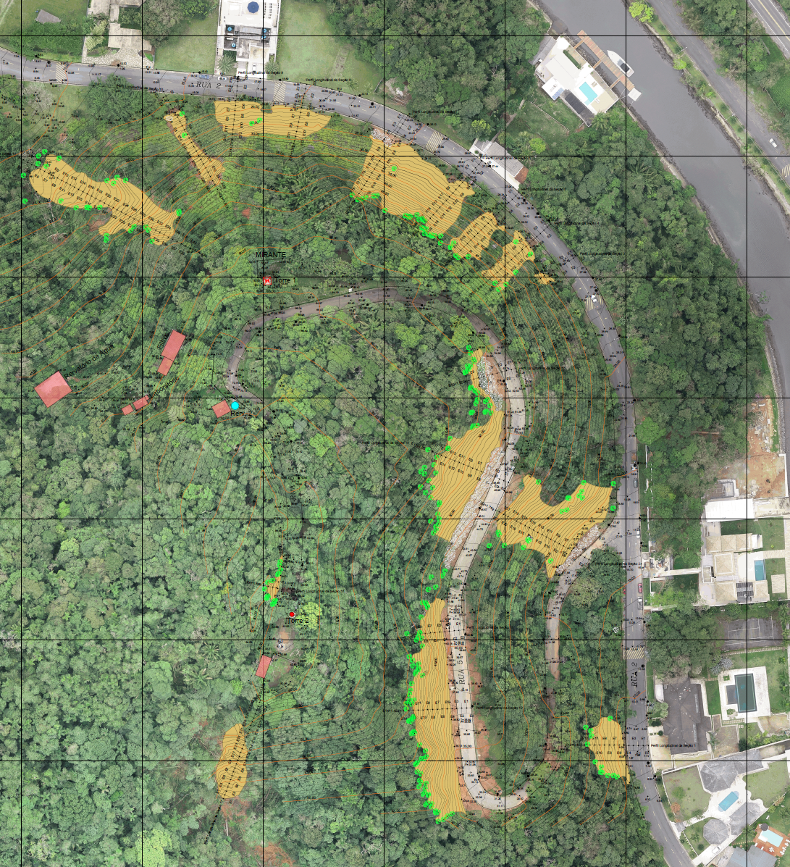
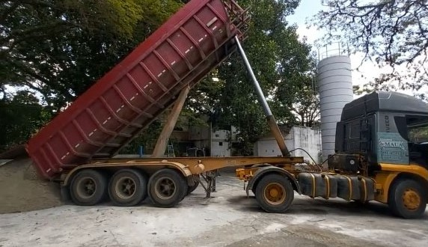
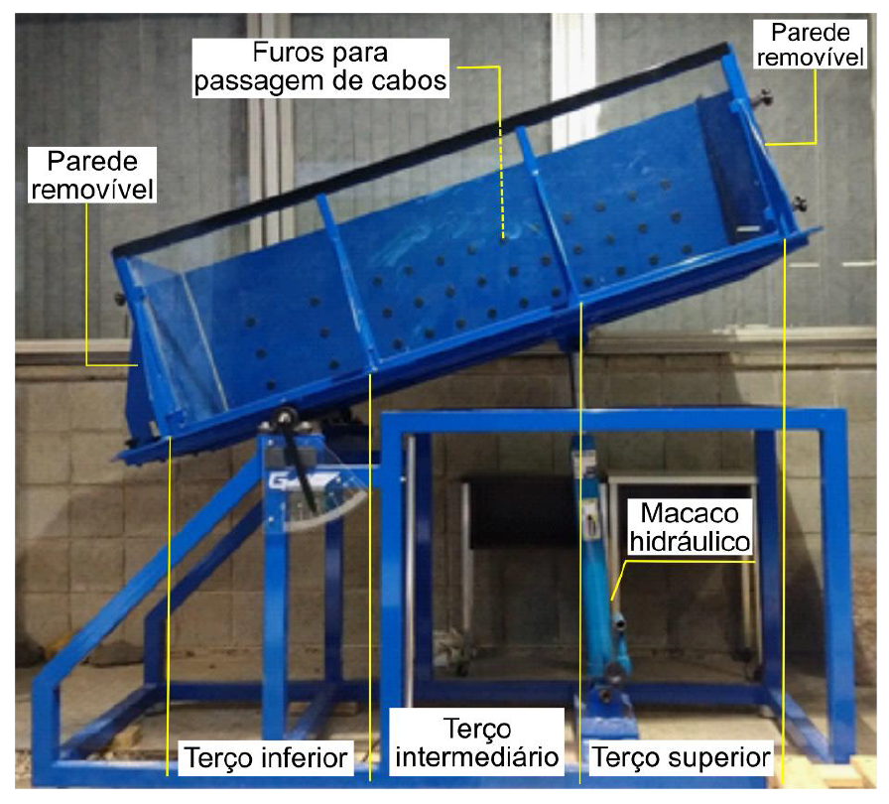
Experimental Phases
Laboratory tests
Dump Trunk
Real slope
Notes:
3 phases

Slide 5
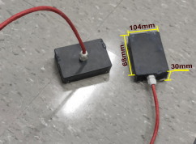
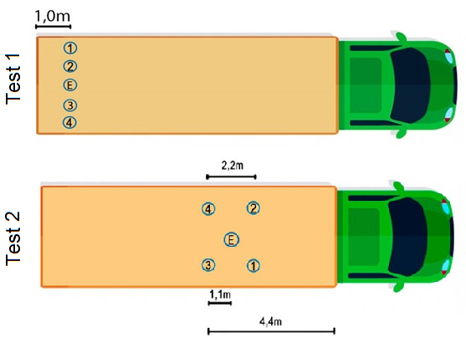
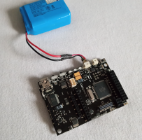
Dump Trunk
KITS:
(E) - ESP32 with an inertial sensor (IMU6050), configured to ± 2g, interconnected by a 2.5-meter cable. Where the microcontroller is on the surface transmitting the data via WiFi and the inertial sensor positioned at 0.5 meters depth (one unit).
(1) to (4) - Waspmote PRO board, internal accelerometer (LIS3331LDH) configured to ± 2g, battery, and SD card storing the data. The kit was at 0.5 meters depth.
https://www.youtube.com/watch?v=gfMwHIyDbDY
Notes:
We did 2 tests, on close to border, and other in the middle of dump box. Using five sensors, from different manufactures. First one the “ESP32” from Heltec, and other from Libelium, the WaspMOTE

Slide 6
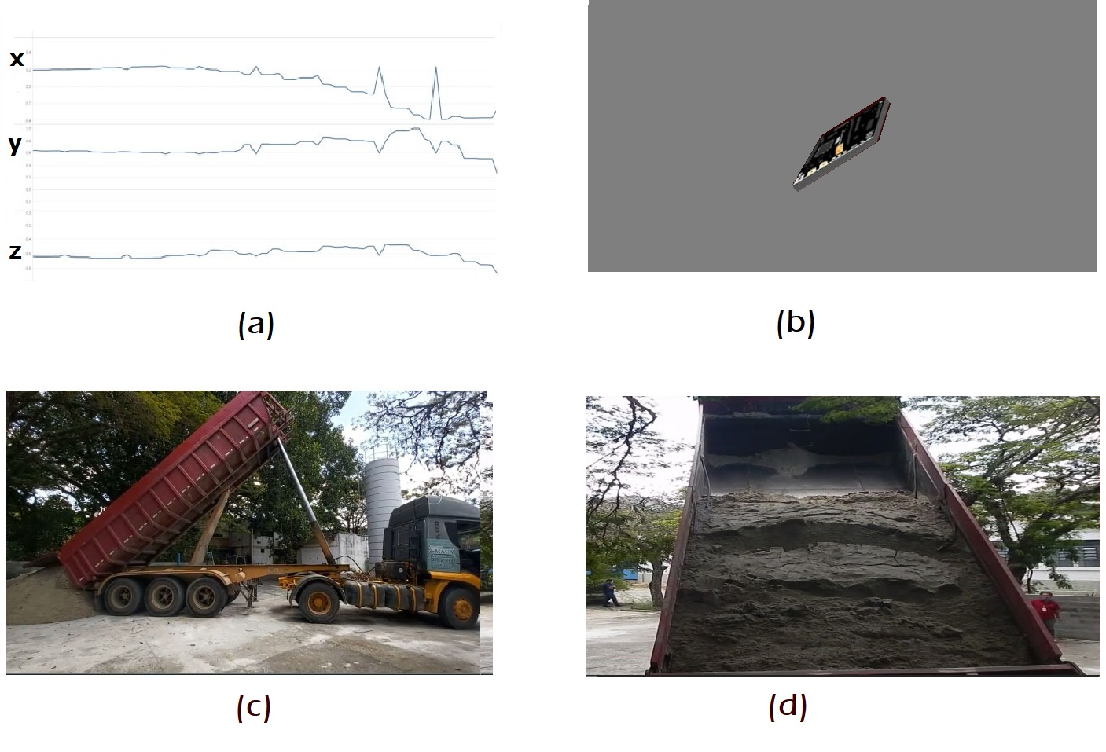
Data visualization
(a) Axles
(b) sensor position
(c) Lateral view
(d) Front view
https://www.youtube.com/watch?v=gfMwHIyDbDY

Slide 7
Test 1
All accelerometer axes identified acceleration variation before the break occurred, indicating a high potential to be used for early detection of landslide.
W4 did not fall out of the dump box and, returned to its original position, but its final acceleration value was slightly different from the initial one.

Slide 8
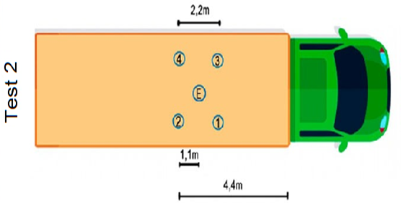
Test 2
linear increment due to dump box tilt movement (from instant 38 s), and occurrence of sand sliding with an abrupt change in acceleration values.
Sliding in 150 s, moving responses of W2 and W4, we observed only oscillations in the responses of W1 and W3, indicating that the movement of the latter was primarily translational during slipping.
From instant 166 s, in which the truck begins to move forward to finish unloading the sand, there is abrupt variation in all sensors until a resting situation is reached, with the sand fully discharged.
Notes:
3 moments
Dump box start to tilt
Sensors 2 and 4 start the sloping
Movement to front and complete slopping

Slide 9
Results and findings
Online submission of all signals is impractical due to energy, data volume and long-term monitoring reasons.
The device at rest works like an inclinometer.
Sampling (g/s) should vary according to vibration level and standard deviation.
Hibernate and wake up must be implemented features.
Data from all sensors can be combined to understand the global phenomenon
Adapted from: J. P. Gomes, C. R. Cunha, G. Noira, and A. Santos, “A cloud-based iot approach to support infrastructure monitoring needs by public civil protection organizations,2021

Slide 10
Recommendations and conclusions
Assess the stability of the long-term sensors (water tightness, influence of temperature variation, etc.) and effects of various disturbances
Sensor node should have mechanisms of data buffering and pre-processing, that allow unnecessary data elimination.
Analyzing use of machine learning, fog or edge computing
Adapted from: J. P. Gomes, C. R. Cunha, G. Noira, and A. Santos, “A cloud-based iot approach to support infrastructure monitoring needs by public civil protection organizations,2021

Slide 11
Guidelines for Video Presentations
Please use the formatting, including fonts, font size, titles and headings, etc. so that the slides deck is consistent.
Videos length should be 10 min for Short papers and 15 min for Full papers
Zoom software could be used to record the video (see here) or alternatively use power point (see here)
The overall theme of presentations is educational. Following IEEE Guidelines, references to specific marketing programs, companies and solutions should be avoided. The exception to this requirement/recommendation is for open source or other publicly available (free to the user) resource.
Avoid reuse of copyrighted materials unless explicit permission has been granted and can be demonstrated
Contact information including email, university and presenter name should appear on the title slide

